Slide 1
Challenge stigma & chance to have fun / do hobbies
Sheffield
Creative curriculum opportunities
September, 2021
Following the Bright Spots findings Sheffield’s children in care council voted on issues they wanted to take forward. They chose stigma. The virtual school offered to support their work & started the journey to developing a creative curriculum.
This is a practice example from the Bright Spots Programme www.coramvoice.org.uk/brightspots

Slide 2
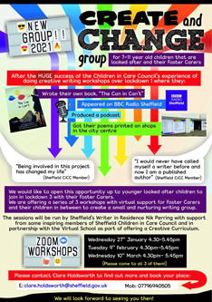
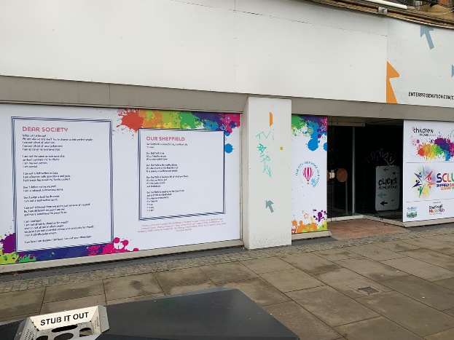
Why?
In response to the Bright Spots survey findings Sheffield children in care voted on the issues they wanted to tackle. One of these was stigma. The virtual school supported & funded this work. Partnerships with professional authors and artists were developed to offer a range of opportunities to children in care and care leavers.
What difference is it making?
Young people have described how important the opportunities have been to them helping to increase their confidence, leading to friendships and fun. Children feel they have been able to speak their own truth about their experiences to diverse audiences of both other young people that were care experienced, Councillors, Senior Managers as well as other key players in the city such as the Head of Music Education, Museums and Galleries and Theatres.
What did they do?
Sheffield children in care and care leavers have taken part in a lots of different creative workshops and sessions. They are really proud of what they have created and achieved. Some highlights include:
Wrote poetry book ‘The Can in Can’t’ – over 100 people attended the launch
Appeared on BBC Sheffield radio & in local news articles
Produced a podcast about their creative work
Poems were printed on shops in the city centre
Dream Big event held at the Leadmill where over 30 young people shared their writing pieces reflecting on their care journeys, identities and ambitions – it was hosted by care experienced young people (and very well attended 220 people came!)
Young people taking part in the work wanted to
challenge the stigma associated with care experience
to inspire others to have high aspirations
and follow their dreams.
After the success of the children in care creative
writing sessions during lockdown the opportunity
was expanded to include younger children
& their foster carers.The ‘Can in Can’t’ book was
highly commended at the Children & Young People
Now awards in 2020.
Being involved in this project has changed my life
(Sheffield CIC member)

