Slide 1
Rights & Voice
Hull City Council
Children’s voice shaping policy and practice
July 2022
Hull took part in the Bright Spots programme – over 400 of their children in care and care leavers took the time to share how they were feeling – what matters to children has shaped Hull’s new practice standards and corporate parenting strategy.
This is a practice example from the Voices Improving Care Team Brightspots@coramvoice.org.uk

Slide 2
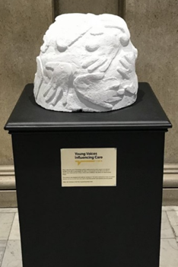
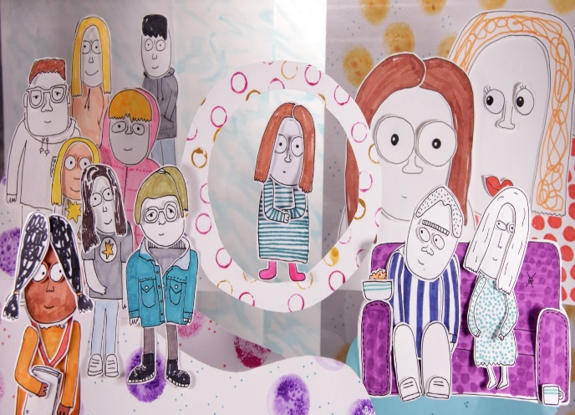
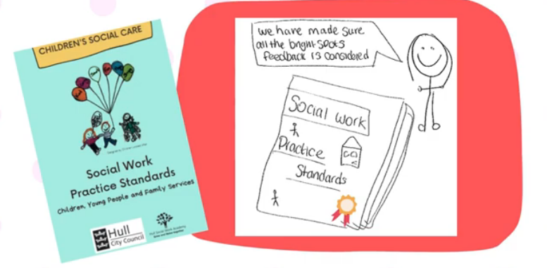
Hull wanted to make sure what matters to children and young people and the things that influence their well-being was at the centre of the work they do at both a practice and policy level.
Hull are committed to creating lots more different opportunities for children in care and care leavers to share how they are feeling and to influence practice and policy.
Why?
Impact
Hull have rewritten their practice standards – these now incorporate the Bright Spots findings.
“By using the standards and expectations within the guide, no matter what is going on in a child or young person’s life they will always receive the consistent support and the right help. We have made sure that the feedback from the Bright Spots survey ahs been considered in all the different areas”.
You can read the practice standards here: https://www.workingforhullcitycouncil.org.uk/downloads/file/6/practice-standards
The new Corporate parenting strategy (2022-2025) has also been structured using the Bright Spots well-being domains and is based on Hull’s Bright Spots findings. The refresh of the strategy is based on extensive consultation with the people who matter most – children are young people (231 children looked after and 151 care leavers via the right spots programme) – the findings told Hull what they need to focus on to improve their lives and experiences and the strategy describes what Hull are doing as a result of the feedback and what they plan to do next. You can read the corporate parenting strategy here (scroll to end of page): https://www.hull.gov.uk/children-and-families/policies-and-performance/looked-after-children-pledge
YVIC (Young Voices Influencing Care) have created a sculpture based on ‘what makes life good’ – the artwork was unveiled by the Hull Chief Executive and is placed in the Guildhall as a reminder of children’s voice (see next slide) .
What?

Slide 3
