Slide 1
Emotional health & well-being
Hull City Council
Hopes and fears
February 2023
Following Hull’s Bright Spots survey the local authority, in partnership with children in care, picked five areas to focus on – one of these was challenging stigma. Hull’s children in care council have produced 12 screen prints – they want to show people they, like other children, have hopes and fears.
This is a practice example from the Voices Improving Care Team Brightspots@coramvoice.org.uk

Slide 2
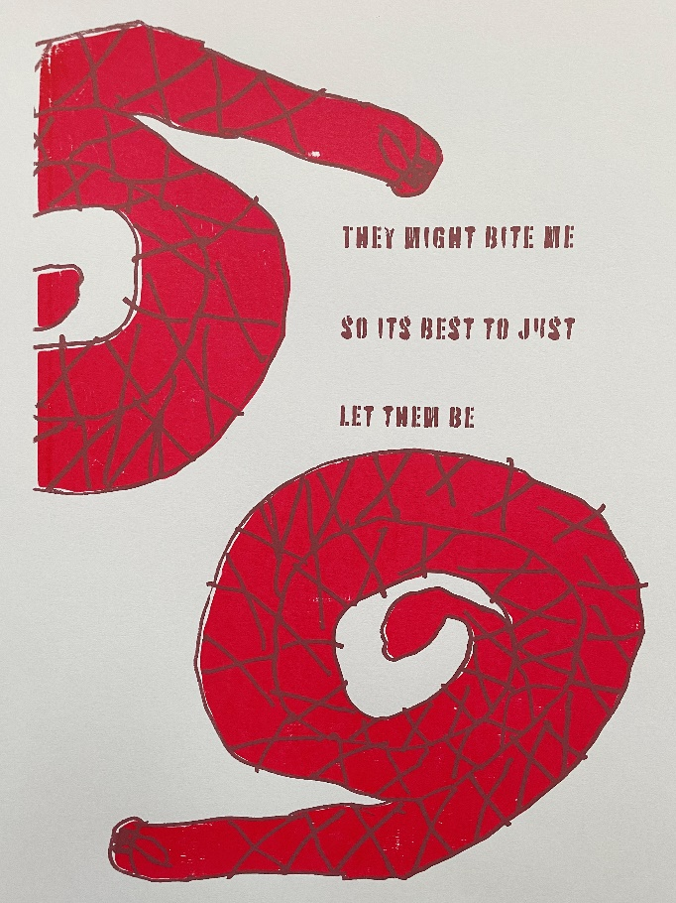
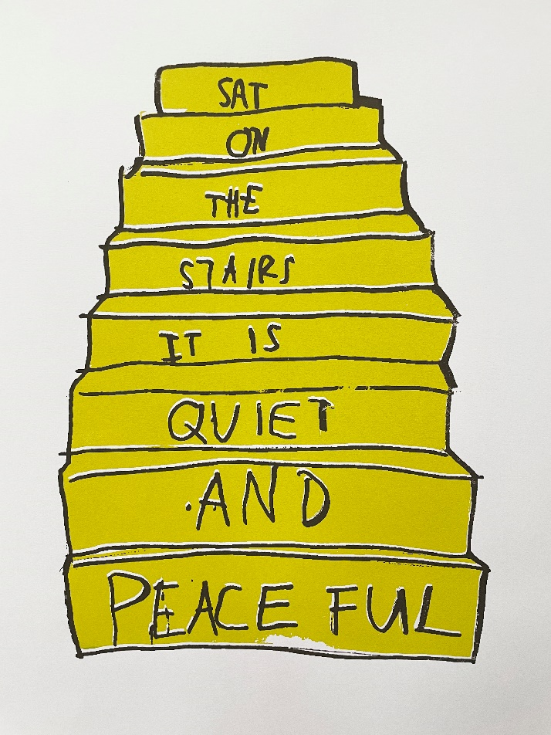
Hull took part in the Bright Spots programme in 2021-22. Over 400 children in care and care leavers shared how they were feelings about the things that mattered to them.
Lots of children in care wrote about feeling different and adults doing things that made them feel embarrassed about being in care – the children in care council (YVIC) – wanted to do a project to challenge people’s perceptions about those who grow up in foster care and children’s homes.
Hull city council are very proud of their young people and the art work they have produced – it is displayed in prominent places across the council.
Why?
Impact
YVIC spent lots of time thinking about the Bright Spots findings and what children in care and care leavers across the city wrote about. One of the things they wanted to work on was challenging negative images about children who have been in foster care or children’s homes.
They want to “get the message across that we are just young people like other young people and we have some of the same hopes and fears that other young people have.” Who likes spiders anyway!? they ask. But they also wanted to share “some of the worries that we feel set us apart too”.
Working as a group “we started with fears, you know spiders and snakes and then began to think about what we wanted to share anonymously with the world about us, moving on to what we wanted to share about our hopes and aspirations and challenge people to consider we are really just young people wanting to live regular lives without the stigma that is associated with being in care.”
Their message is clear “consider our hopes and fears and support us with both.”
The group have produced large screen prints – these are displayed in council buildings – small versions of the artwork are available for sale in a local gallery in Hull.
On the next slides there are examples of the art work. The group are really pleased with their pieces – they are bright and memorable.
What?

Slide 3
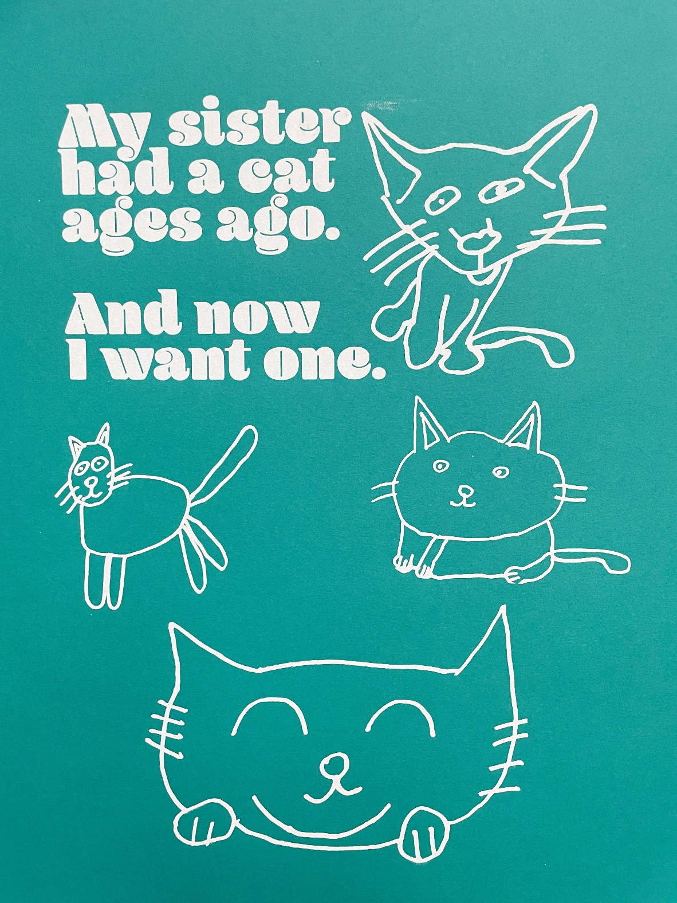
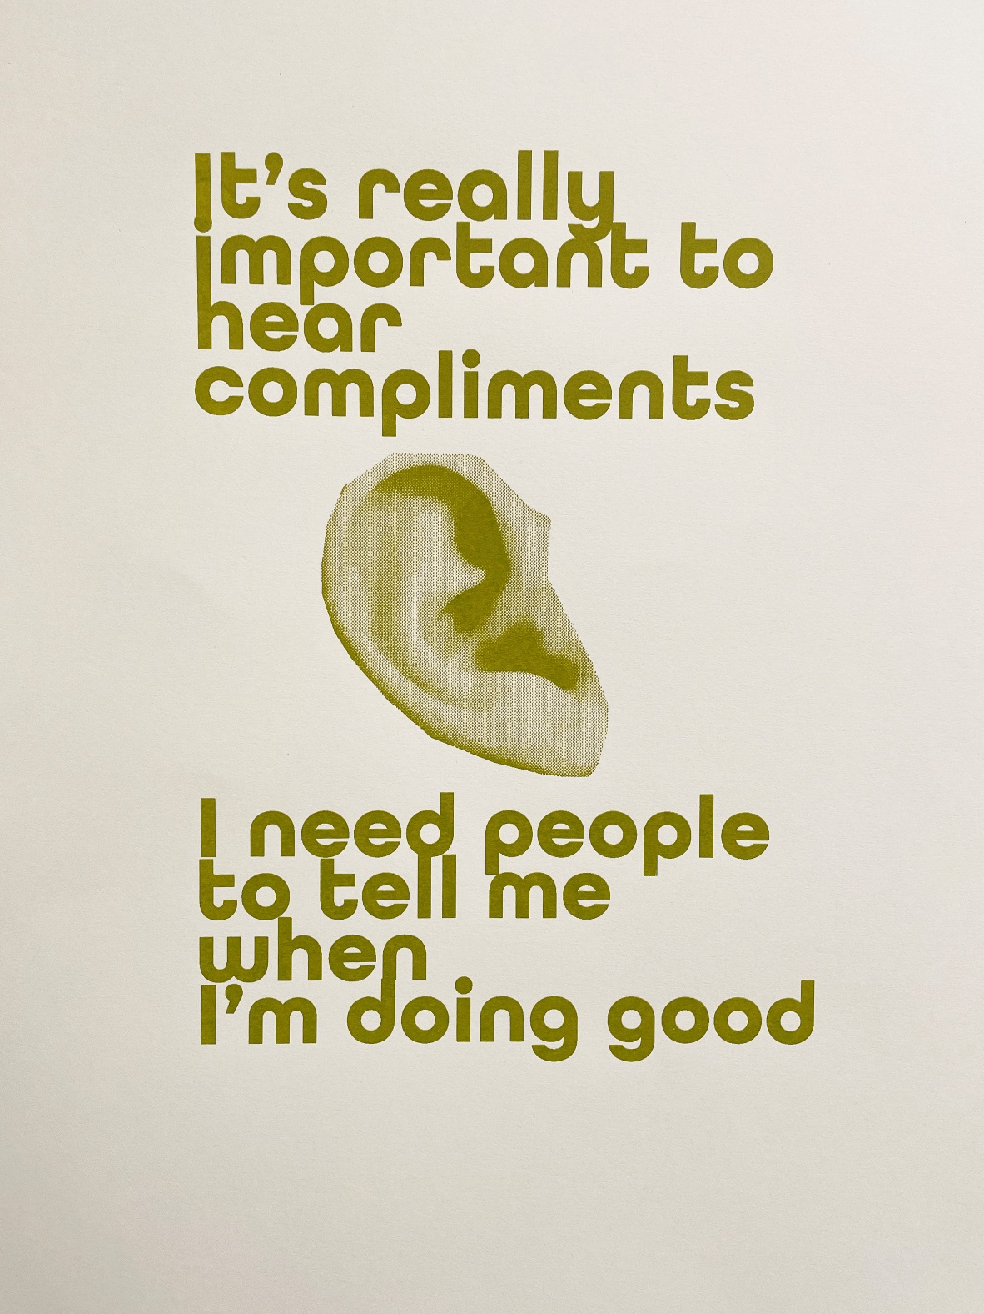

Slide 4
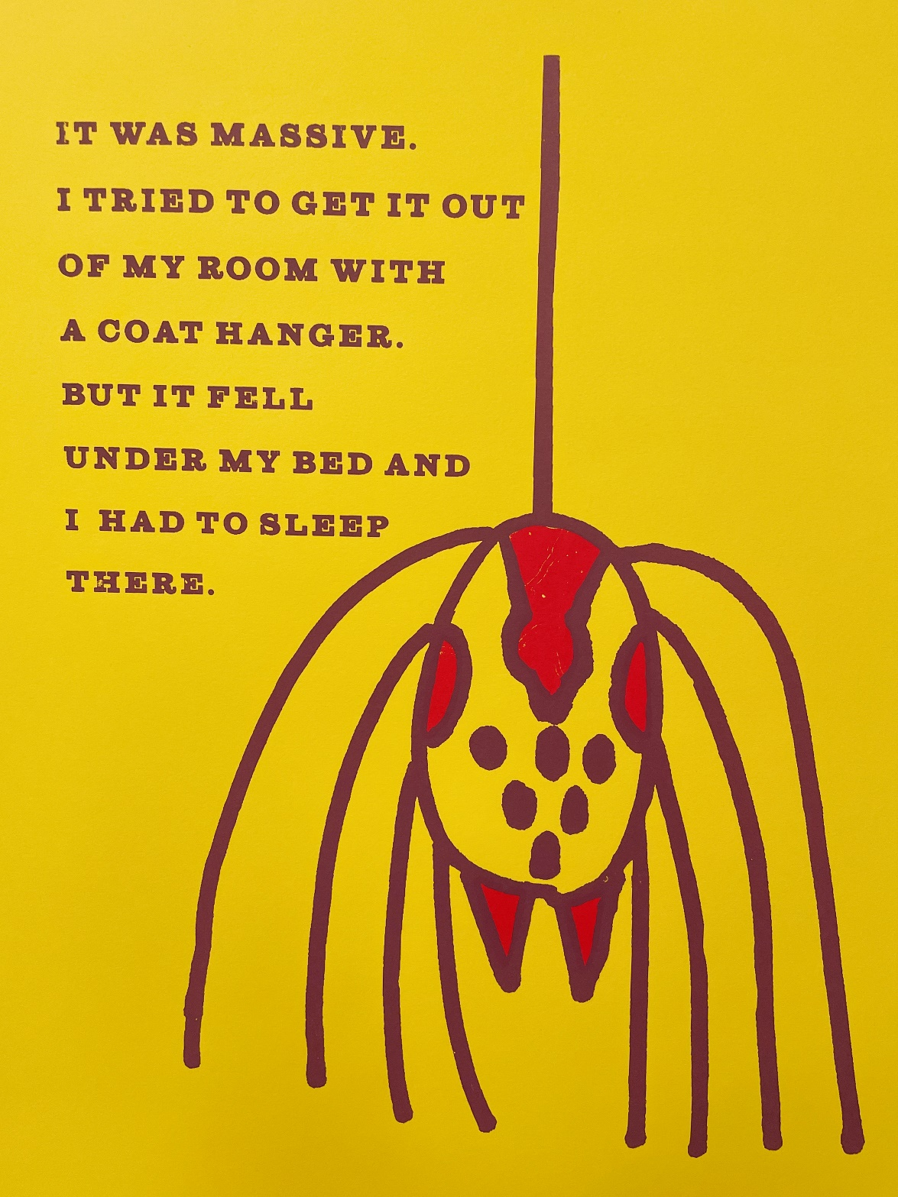
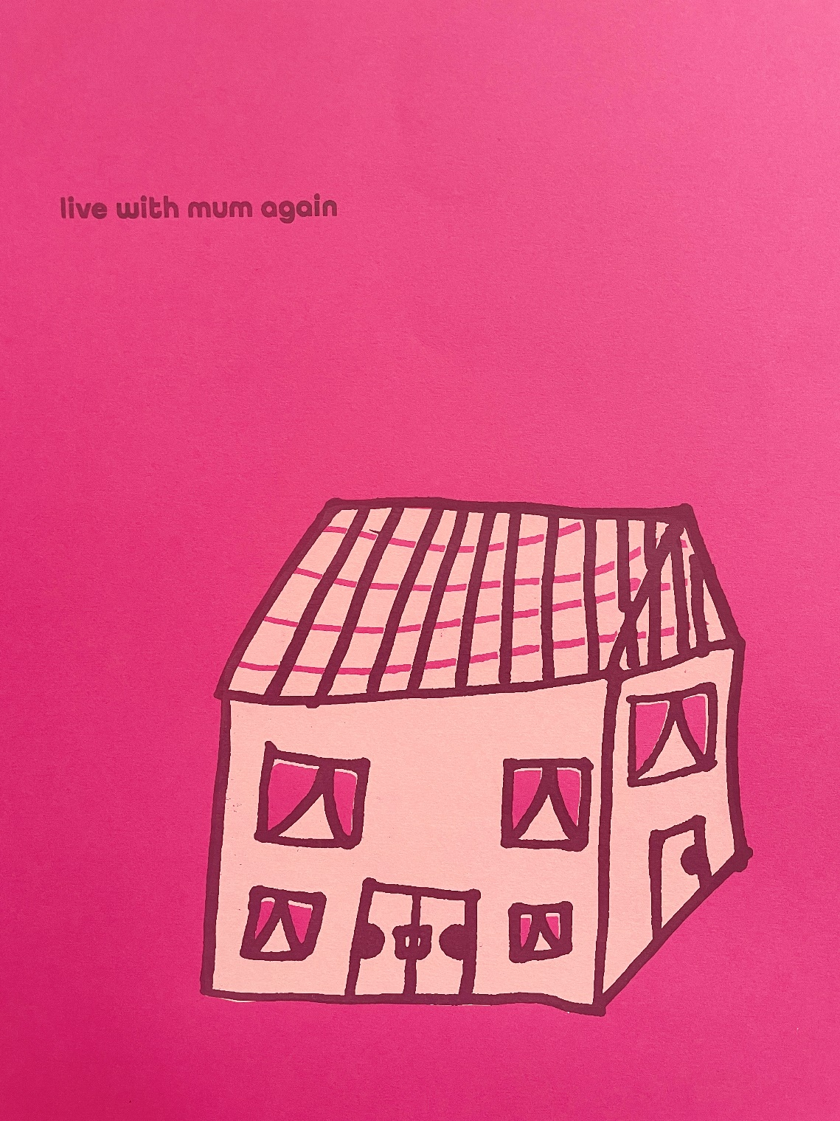

Slide 5
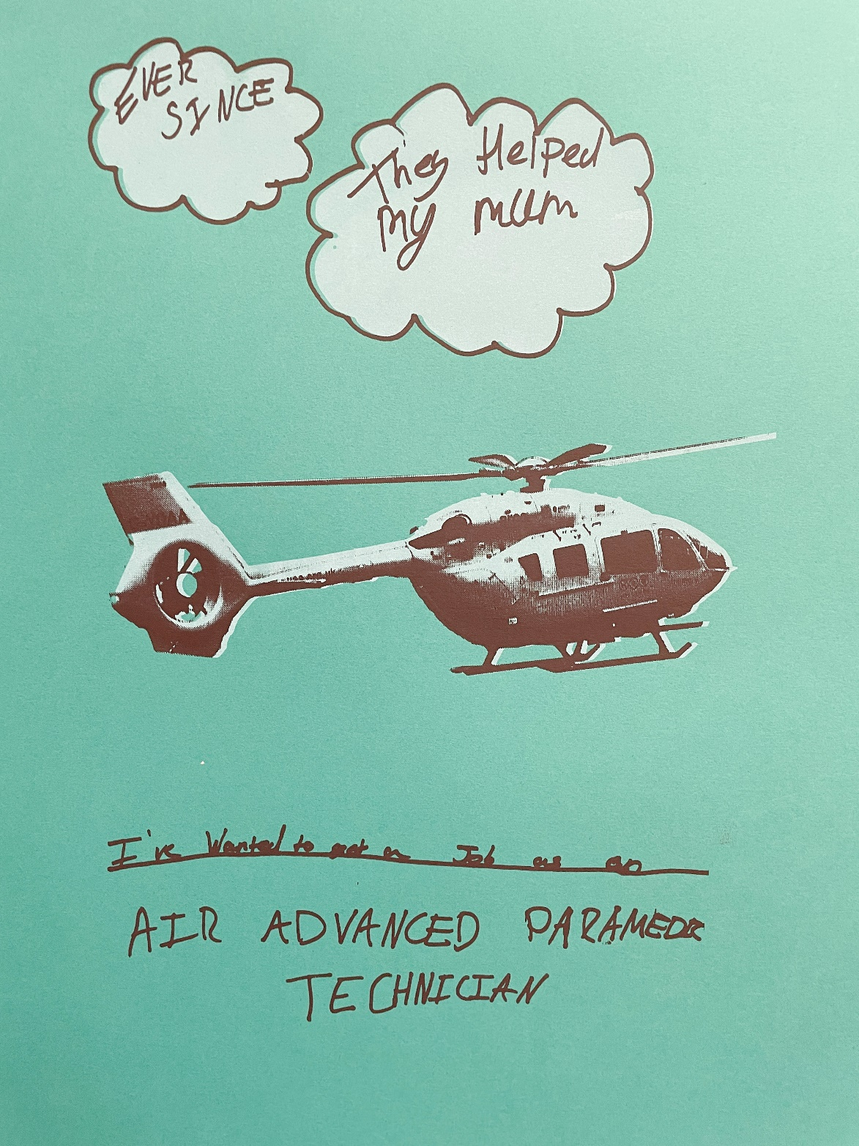

Slide 6
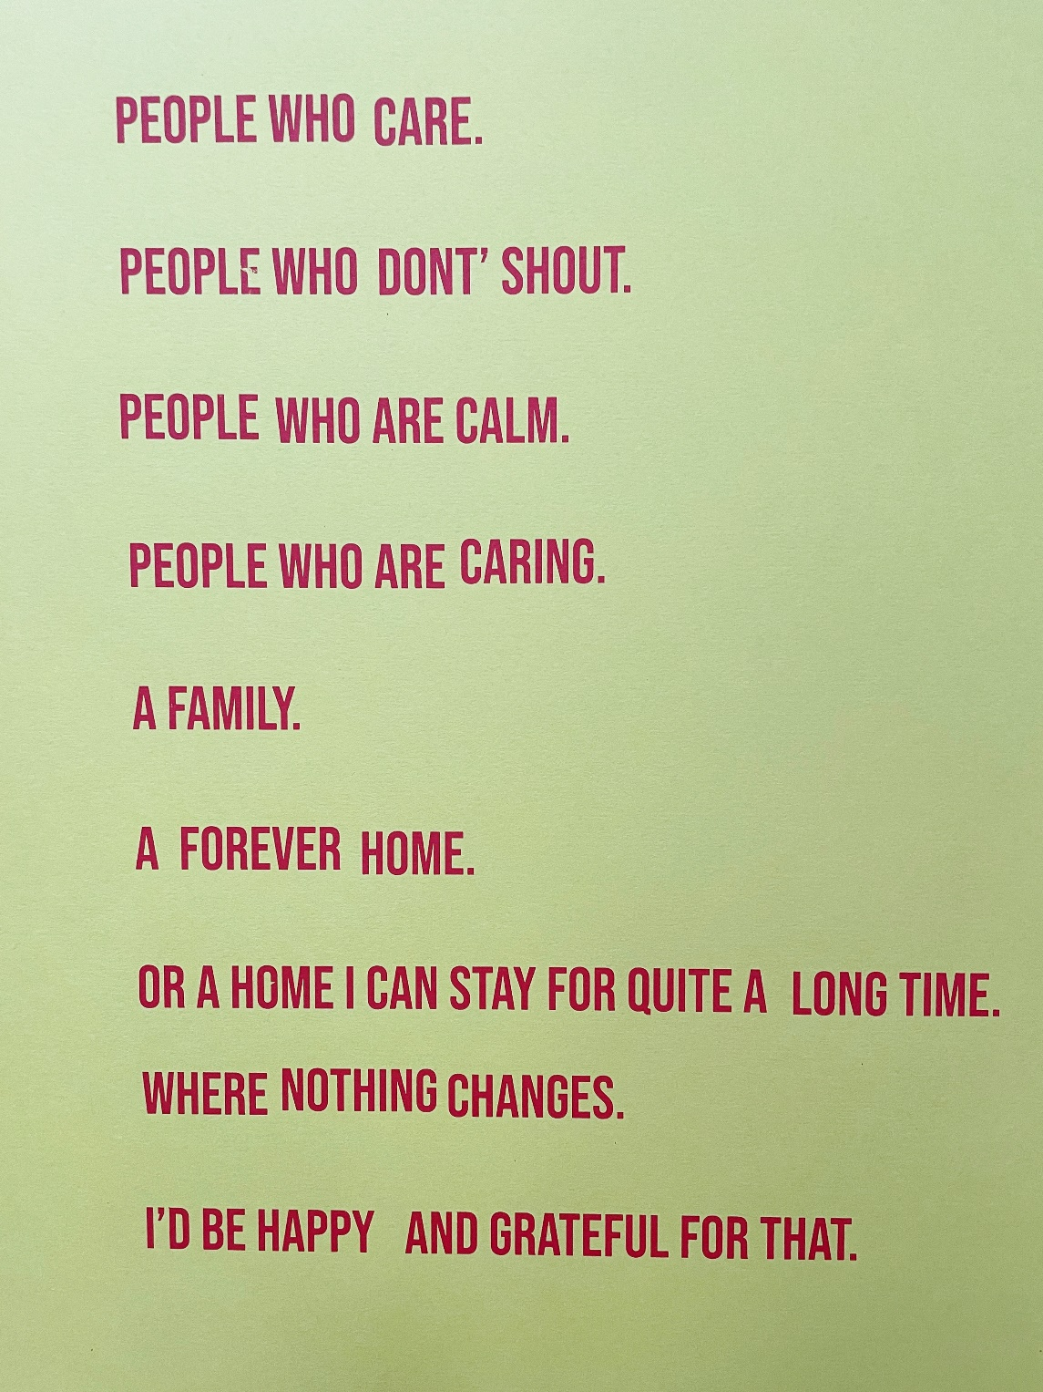
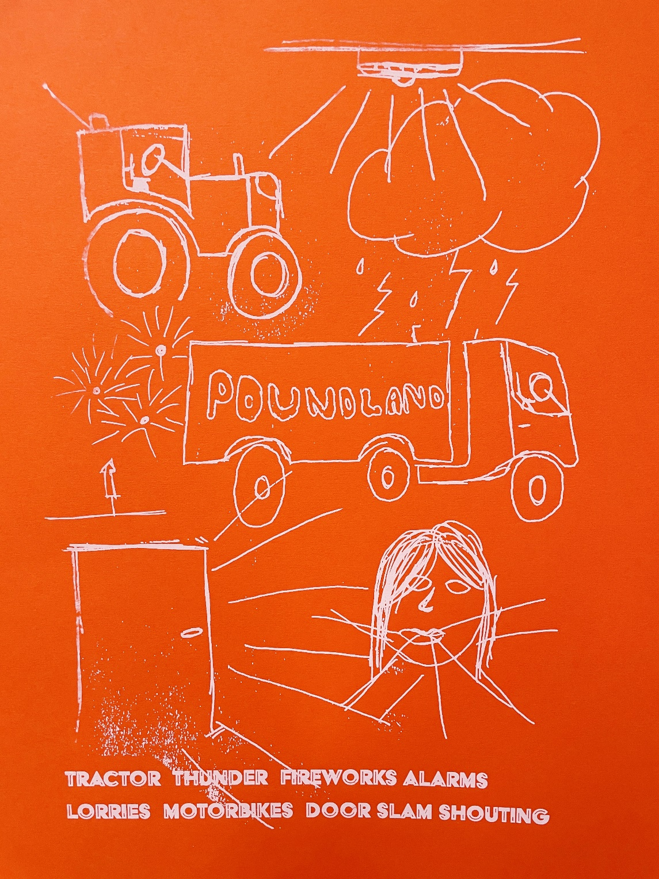

Slide 7
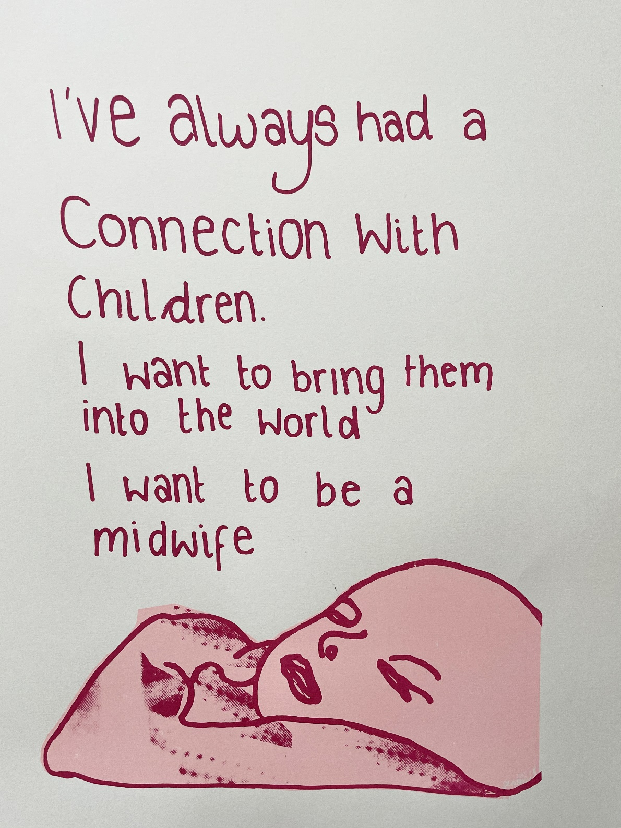

Slide 8
