Slide 1
Rights & Voice
Hull City Council
Stigma and feeling different
July, 2022
Following Hull’s Bright Spots survey, the local authority, in partnership with children in care, picked five areas to focus on – one of these was challenging stigma.
This is a practice example from the Voices Improving Care Team Brightspots@coramvoice.org.uk

Slide 2
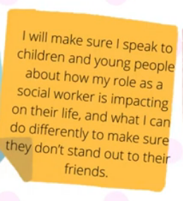
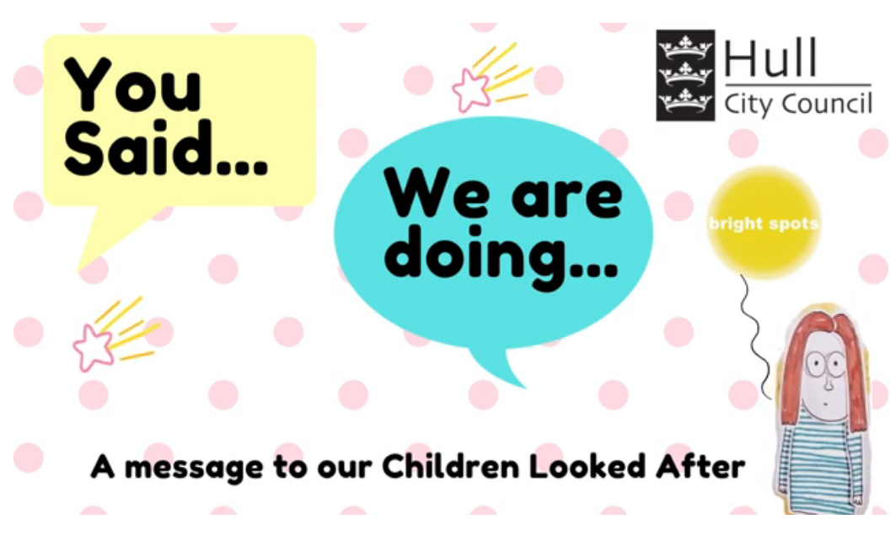
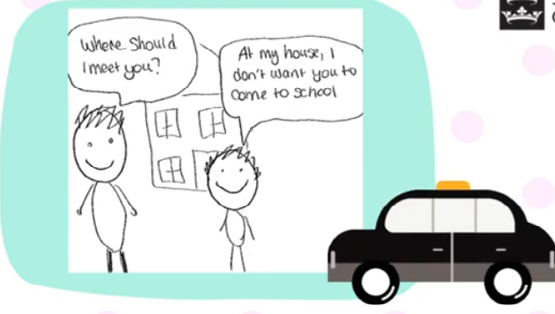
Why?
Hull took part in the Bright Spots programme in 2021-22. Over 400 children in care and care leavers shared how they were feelings about the things that mattered to them. Just over 1 in 10 (12%) young people aged 11-17 years recorded that adults did things that made them feel embarrassed about being in care. Young people wrote about how their carers or teachers would do things that singled them out as different – referring to them as ‘being in care’ when talking to others or calling them to meetings during school time: young people wanted those who cared for them to be more mindful of their actions.
Hull have disseminated the findings across their services in team
meetings and events. They have created a ‘ words and pictures film’ which includes messages from social workers about what they are going to do in response to Bright spots findings. The film has been shown to the children in care council and a letter has been sent to all children in care to tell them about next steps after the Bright Spots findings.
Watch the film: https://www.youtube.com/watch?v=Ma2tE45e1Qs
Impact
What?
Hull, in partnership with their children in care council, picked five top areas to respond to immediately after the survey results. One of the themes in the initial phase is: challenging stigmatising practice.
To make sure everyone has a chance to listen to and reflect on the Bright Spots findings Hull developed a 1.5 hour session for workers across the services.
Alongside learning more about how children are feeling, a big focus in the sessions is to create space for workers to reflect on how the findings make them feel.
Each worker is asked to make a pledge of things they can do in response to the findings on how Hull’s children are feeling. Seven sessions have been run and over 450 practitioners workers have taken part so far.
Following the sessions posters have been created and are displayed in offices (e.g. next to tea & coffee area). The A3 posters focus on ‘you said’ and ‘we will do’.
On the next slide there are examples of Hull actions to support children in care in relation to policies and practices which can make children feel different, for example: “More will be done by social workers and IROs in reviews to make plans around children and young people being able to go out with their friends, have mobile phones and be able to go on sleepovers, to stop children and young people feeling different.”

Slide 3
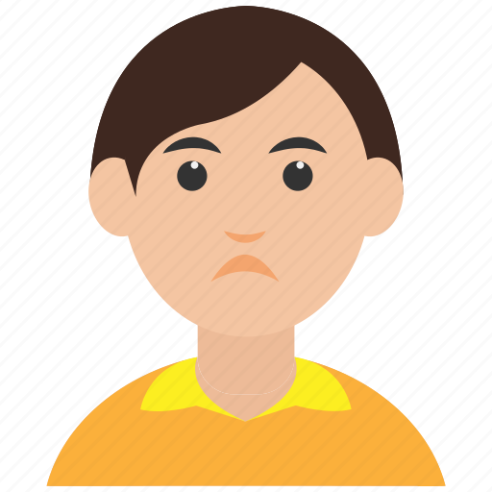
We are doing:
I don’t like to talk about where I will go next and I also don’t like to talk about being in care because if I am happy and somebody talks about me being in care it makes me upset. - 8-11yrs
As part of reviews, IROs have promised they will always ask children and young people about their friendships and recognise that hobbies and activity groups don’t mean people have friends at these groups.
More will be done by social workers and IROs in reviews to make plans around children and young people being able to go out with their friends, have mobile phones and be able to go on sleepovers, to stop children and young people feeling different.
Our social workers have made promises that they speak to children and young people about how their role as a social worker is impacting on their life, and what they can do differently to make sure they don’t stand out to their friends.
We are training and supporting our social workers to use Mind of My Own (MOMO) as a platform where our children and young people can share their wishes and feelings, and where social workers can promote the ‘all about me’ option to allow young people to share the best ways they like to share their views and feelings.
14% of our children in care said they didn’t have a good friend.
I like my bedroom but it is small. I didn’t have anyone to play football with yesterday.
4-7yrs

