Slide 1
Family time
Hull City Council
Supporting family time
July 2022
Following Hull’s Bright Spots survey the local authority, in partnership with children in care, picked five areas to focus on – one of these was supporting children more to stay connected to the people who are important to them.
This is a practice example from the Voices Improving Care Team Brightspots@coramvoice.org.uk

Slide 2
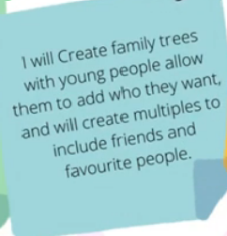
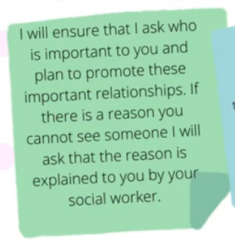
Hull took part in the Bright Spots programme in 2021-22. Over 200 children in care answered the surveys sharing how they were feeling in relation to staying connected with the people who were important to them. About a quarter of children and young people (8-18yrs) wanted to see members of their family more: their mum (29%), dad (28%) and siblings (34%).
Impact
Why?
Hull have disseminated the findings across their services in team
meetings and events. They have created a ‘words and pictures film’ which includes messages from social workers about what they are going to do in response to the Bright Spots findings. The film has been shown to the children in care council and a letter sent to all children in care to tell them about next steps after the Bright Spots findings.
https://www.youtube.com/watch?v=Ma2tE45e1Qs
Hull have developed a 1.5 hour session for workers across the services to listen to and respond to the Bright Spots findings. Alongside learning more about how children are feeling, a big focus is to create space for workers to reflect on how the findings make them feel. Each worker is asked to make a pledge of things they can do in response to the findings.
Seven events have been run and over 450 practitioners have taken part.
Following the sessions posters have been created and are displayed in offices (next to tea & coffee area). The A3 posters focus on ‘you said’ and ‘we will do’. On the next slide there are examples of Hull actions to support children in care in relation to staying connected to important people in their lives including:
Establishing a working group to focus on family time;
Ensuring Independent reviewing officers (IROs) will now always ask questions about family time as part of reviews – checking there is a clear plan for children and young people around having time with people who are important to them and explanations when this is not possible.
What?

Slide 3
We are doing:
I at
least want to see my mum again [even] if it’s one time, because I don’t remember anything.
11-18yrs
We have created a ‘Working group’ reviewing family time arrangements and taking on board the feedback from YVIC (children in care council) & Bright Spots findings.
Staff who attended the Bright Spot events have made promises to how they will change their practice or work within their teams as a result of what our children and young people have said.
Our IROs have promised that as part of a child or young person’s looked after review, they will always ask questions about family time. As part of this, they will make sure there is a clear plan for children and young people around having time with people who are important to them and explanations when this is not possible.
Our family time workers now sit within our social care teams so children and young people get consistency and timeliness in regards to being able to spend time with people who are important to them.
We are in the process of facilitating more training on life story work as every child and young person should have as much information about their life as possible from before they were looked after. Practice learning sessions are taking place to support social workers to help them find the best ways of getting information about children’s families and history, so they know where they came from and who was part of their life.
Arranging contact takes too long, we don’t know enough about why we can’t see certain family. Family time can help us cope.
- YVIC Feedback

