Slide 1
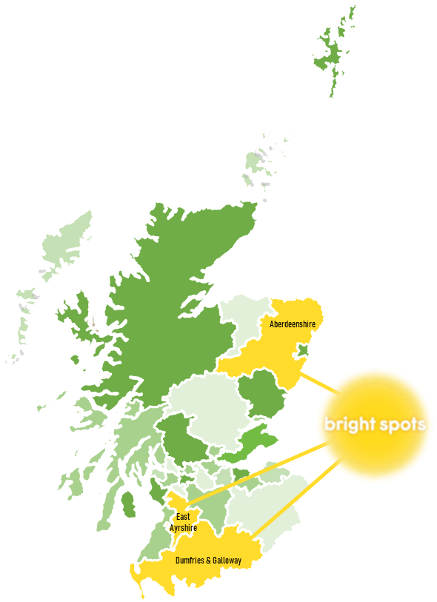
Bringing Bright Spots to Scotland Micky Anderson CELCIS
UK-Ireland INTRAC Network, May 2023

Slide 2
Background
Who took part?
Relationship with workers
Wellbeing questions

Slide 3
Key underlying principles
Focus on what care experienced children and
young people say about their lives and what is important to them: Subjective wellbeing (feeling good and doing well at an individual and interpersonal level)
Ensure the views and experiences of children influence service development and strategic thinking
Share good practice between local authorities by encouraging opportunities for learning and development
Notes:
Catalyst for engagement with care leavers

Slide 4
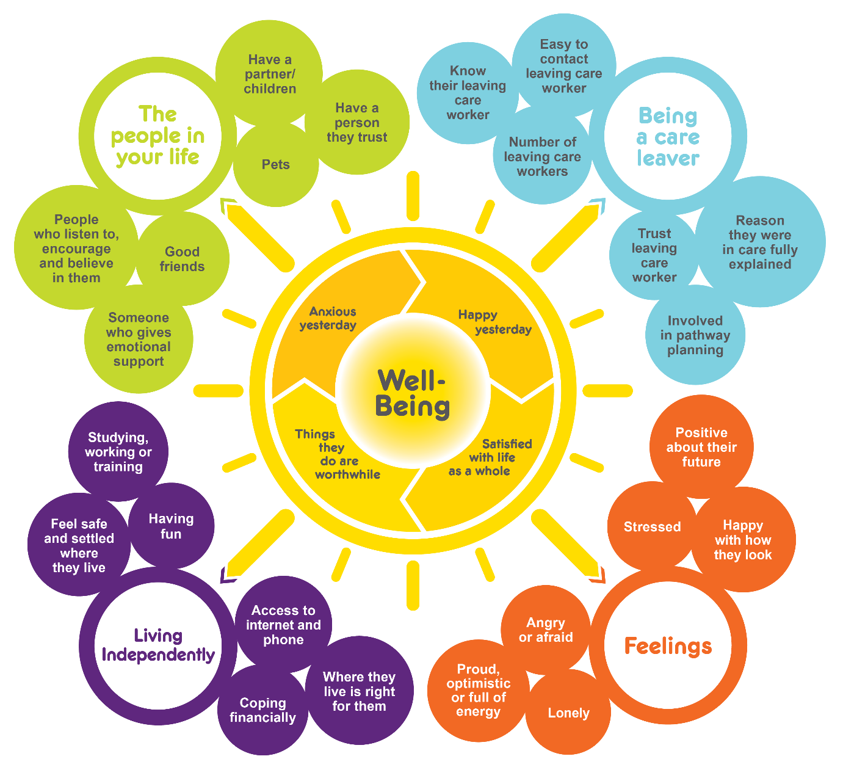
Development of the Your Life Beyond Care survey funded by Coram-i, through the Department for Education Social Care Innovation Fund
Co-produced in 2017 with 31 care leavers
Builds on experience with Your Life Your Care survey for children and young people in care
Your Life Your Care carried out at same time in our three areas

Slide 5
Who took part?
425 young people identified as eligible
218 took part
51% response rate (41% to 70% across areas)
Notes:
83% of children in care were white, 95% in 2011 census

Slide 6
Gender: Young women over-represented
Notes:
Care leavers is Scottish care leavers 16+ in 2021. SG CLAS data.
Young women over-represented. Same in England. 62% female in one LA

Slide 7
Long-term health problem or disability that limits day-to-day activities
Mental health a recurring theme
I was thrown out of care far too early when I had far too many emotional and care needs, especially where my disabilities were concerned
My anxiety and low moods are hard to manage sometimes

Slide 8
Daily activity

Slide 9
Health/disability and feelings about home

Slide 10
Relationship with workers
Different models of support:
leaving-care worker
throughcare/aftercare worker
social worker (continuity of relationship)

Slide 11
Sources of emotional support
Notes:
Second only to friends as a source of emotional support

Slide 12
She has been an absolute angel and a real credit to through care. She has helped and supported me through so much and kept my head above waters, she has been there for me when not one other person ever bothered
I feel my social worker is very supportive, understanding and definitely shows she tries her best to make my life as easy as possible and wishes me the best
I have had a great experience with my leaving care worker and find her useful
My support worker is leaving soon because her contract will finish soon. I really like her she is an amazing person helping me and other boys a lot. Please renew her contract 🙏 we don't want her to leave

Slide 13
Not working for everyone…

Slide 14
Worker access and trust comparison

Slide 15
Wellbeing scales: Four questions
Overall, how satisfied are you with your life nowadays?
How happy did you feel yesterday?
Overall, to what extent do you feel the things you do in your life are worthwhile?
How anxious did you feel yesterday?
Low scores on two or more questions = Low wellbeing
Very high scores on two or more questions = Very high wellbeing

Slide 16
Very high wellbeing scores

Slide 17
Low wellbeing scores

Slide 18
Factors associated with very high wellbeing

Slide 19
Factors associated with low wellbeing

Slide 20
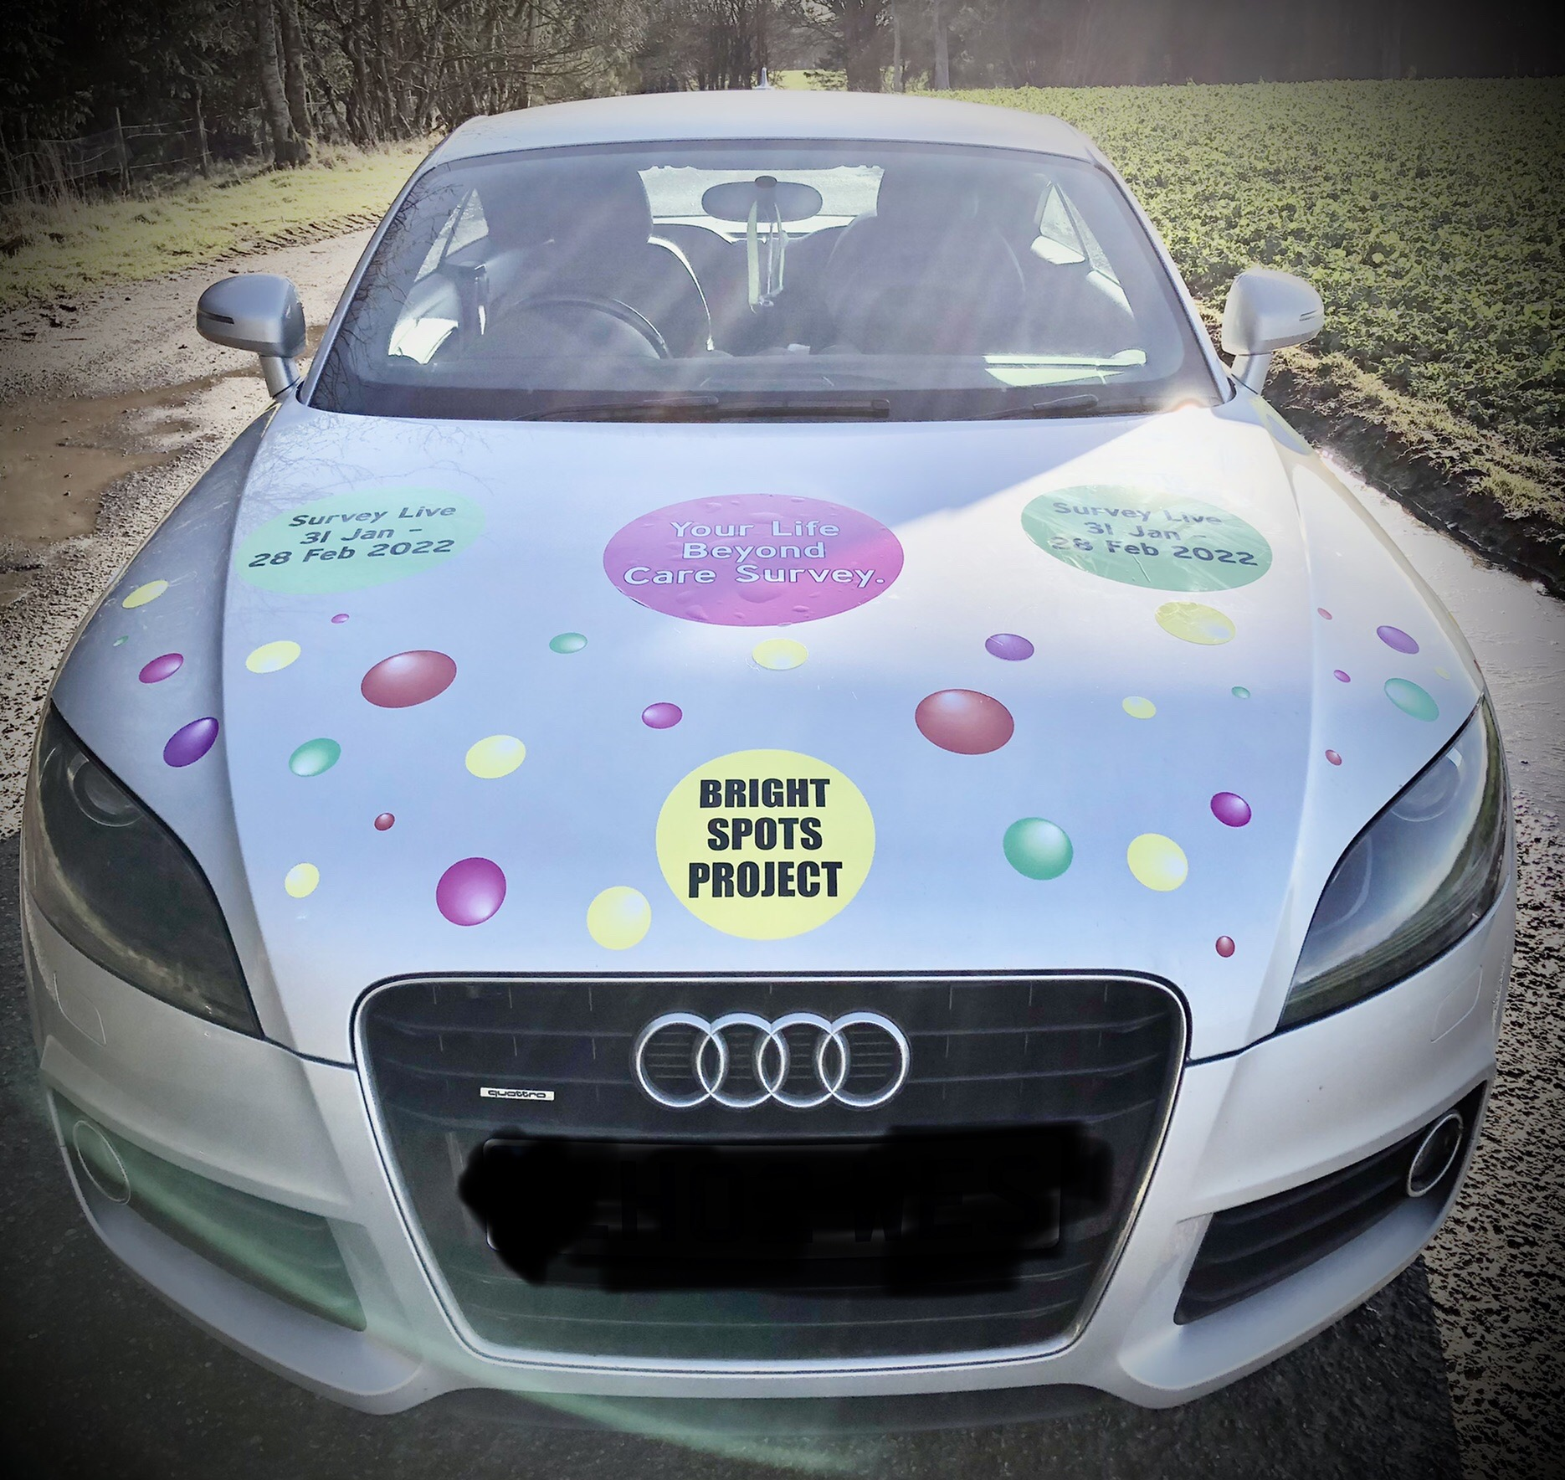
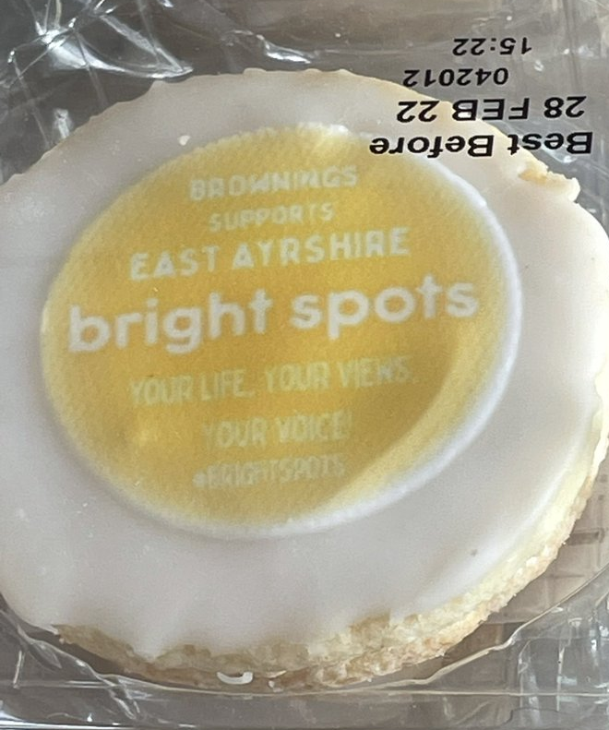
Notes:
Housing Service to provide a “Stepping Stone” service to vulnerable young people leaving care

Slide 21
Further information
CELCIS Bright Spots pilot programme
https://www.celcis.org/brightspots
Coram Voice Resource Hub
Bright Spots Resource Hub - Coram Voice
Report on Your Life Beyond Care in England
What Makes Life Good: Care leavers’ views on their well-being (2020) - Coram Group : Coram Group
Developed with funding from

