Slide 1
Measuring what matters: what care leavers’ say is important to their well-being
Dr. Claire Baker, Coram Voice
Funded by

Slide 2
Children and young people as ‘experts’ in their lives
Helps local authorities
systematically listen to
their children in care
and care leavers about
the things that are
important to them
Official statistics
Objective measures and professional assessments
Children in care and care leavers viewpoints
Are they happy, safe and feel they are doing well?
Bright Spots Well-being indicators
Your Life, Your Care
Your Life Beyond Care
Subjective Well-being: Feeling good and functioning well at an individual and interpersonal level.

Slide 3
About the Bright Spots Programme
Partnership between Coram Voice & the University of Oxford funded by the Hadley Trust to help LAs:
Co-produced with CYP
based on what 170 children in care and care leavers said was important to them and what made life good.
Evidence based
developed over 7 years of research.
international literature reviews
piloting and cognitive interviews
Four surveys created:
Your Life, Your Care (children in care 4-7ys, 8-11yrs, 11-18yrs)
Your Life Beyond Care (care leavers 16-25yrs)
Identify how children & young people feel
Inform service development

Slide 4
Measuring what matters
To understand what contributes to quality care and after care experiences we need to hear directly from those who know the care system best – young people themselves
But in England national data has many gaps – only provides a partial view of care leavers’ lives
3 main items collected (‘in touch’; in education/employment’; in ‘suitable accommodation’)
Problems with this approach
Who records the information (professionals judgements)
What collected – none based on what young people think important in their lives
When published – out of date
The ‘care system’ collets data on what matters to itself, and not on what matters to the people who live in and around it
(the Promise, Scotland, 2022)

Slide 5
What is important to children and young people is not always the focus of children's social care. But we feel it should be.
Notes:
For almost a decade the Bright Spots programme has worked with children and young people to explore what they feel makes their lives good.
We have found that what is important to children and young people is not always the focus of children's social care. But we feel it should be.

Slide 6
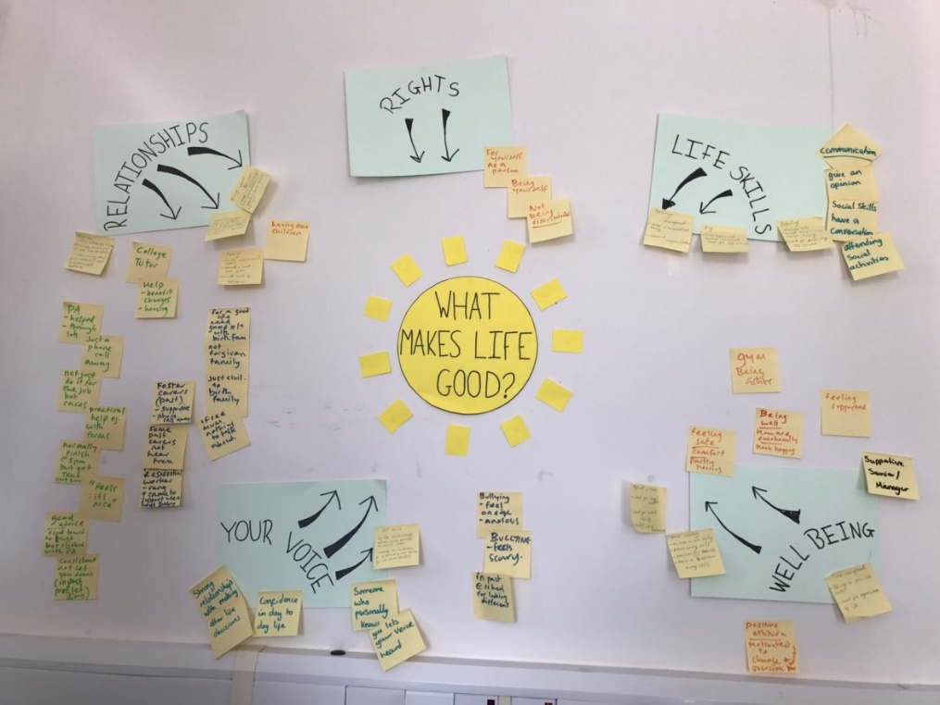
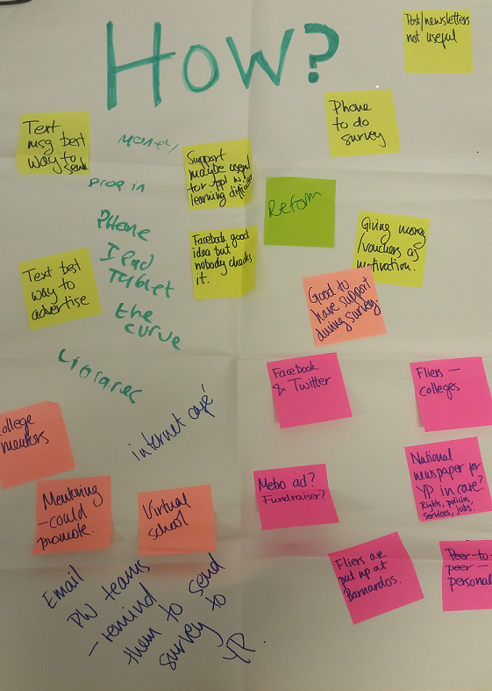
Developing the well-being indicators / survey
What makes life good?
Discussing & changing the questions
Distributing the survey (how reach all care leavers?)
The findings and next steps

Slide 7
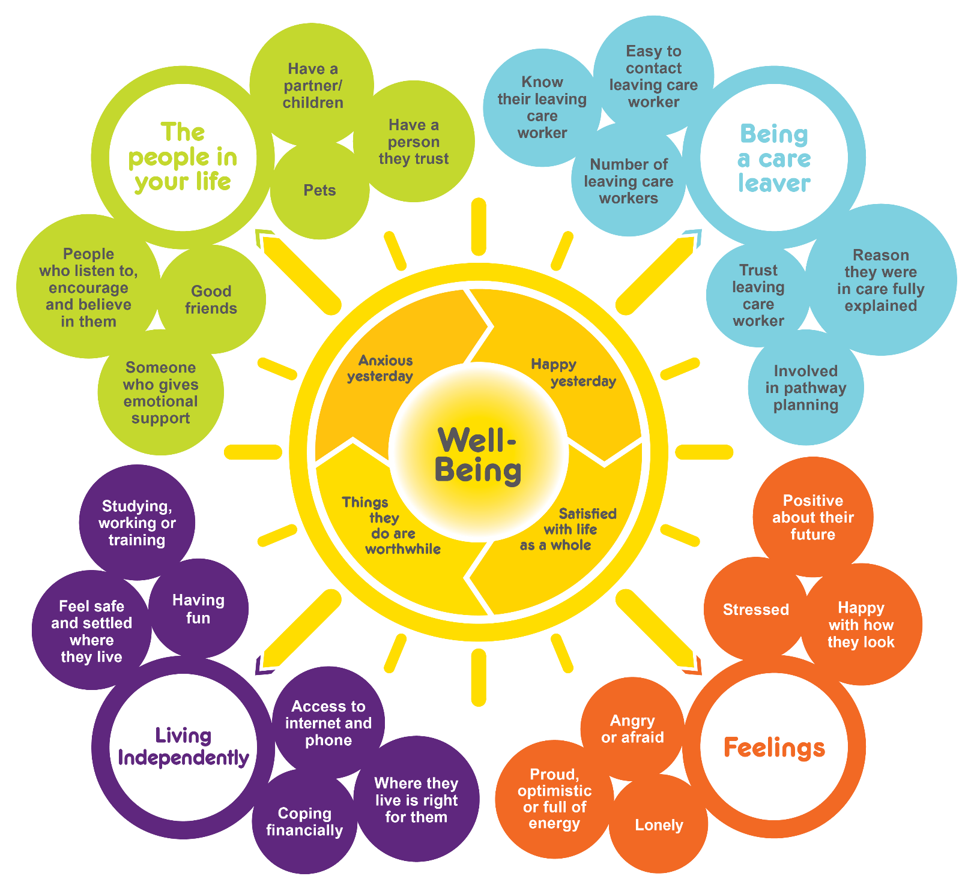
Focus on what makes a good life..
Your Life Beyond Care
Bright spots well-being indicators
Co-produced with care leavers
Shift focus of the care system to areas that may have been neglected – greater emphasis on what is important to young people.

Slide 8
Notes:
Linda

Slide 9
Central question
What makes life good?
I know how to live independent like surviving; I don’t know how to live independent as in like being happy and living
Aspirations: Growing up is about more than just preparing young people for independent living
Notes:
Time to Reflect…CHAT function
What makes your life good? (people, places, activities…)

Slide 10
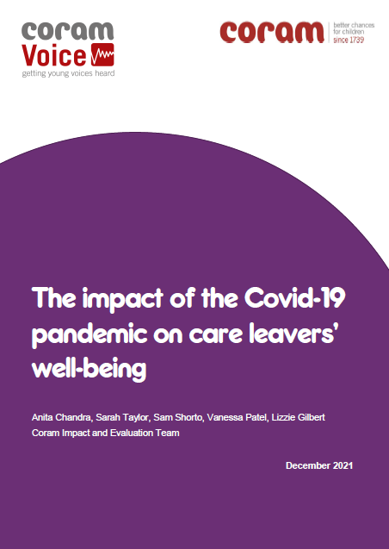
2020
Notes:
The Bright Spots programme is a partnership between Coram Voice & the University of Oxford. Between 2017 and 2022 we have had over 7,000 responses from care leavers in 47 local authorities to questions in the Your Life Beyond Care survey.

Slide 11
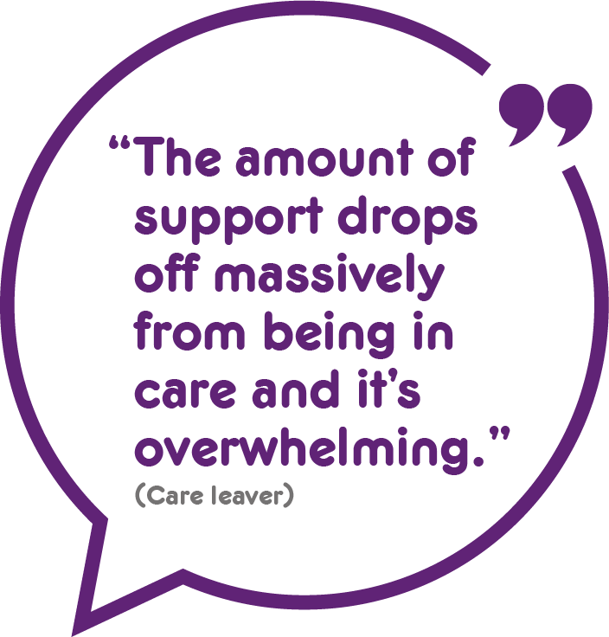
Our analysis showed a steep decline in well-being when young people left care.
We found that compared with children in care a higher percentage of care leavers felt unhappy, unsafe and unsettled where they lived.

Slide 12
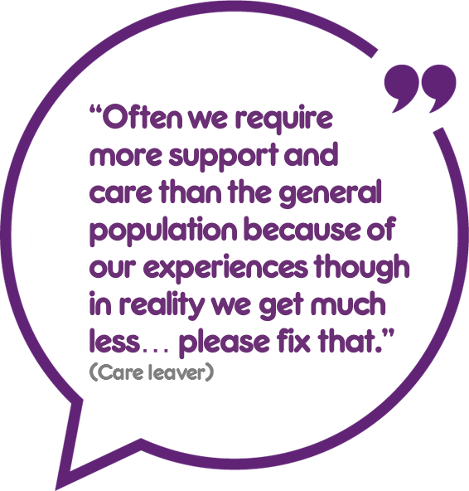
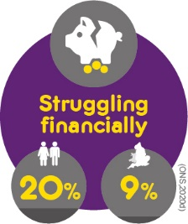
Care leavers report they are doing worse than the general population on a range of measures.
Notes:
Many care leavers do worse than young people in the general population – experience higher anxiety, feel unhappy, dissatisfied with life and that the things they do in their life are not worthwhile.
more care leavers had higher anxiety, lower life satisfaction, felt lonely and were less likely to have trusted supportive people in their lives

Slide 13
The care system can get it right. We can learn from the positive experiences of those with high well-being. We also found that care leavers do better in some local authorities than in others
Notes:
Pandemic sample: high levels of low well-being persisted, but not worsened as may be expected. Slight improvements e.g. coping financially and digital access
Protective factor? Emphasis on well-being and local and national initiatives to support care leaver (UC, laptops and wifi, increased contact & online activities)

Slide 14
Well-being
Very high: 24%
Overall, although a majority of care leavers had moderate to high well-being 30% had low well-being.
Low: 30%

Slide 15
All the things that we ask about in the Your Life Beyond Care survey are important to care leavers’ well-being. But our analysis showed that some things were more strongly associated with well-being. These will be particularly important to focus on in order to make care leavers’ lives good.

Slide 16
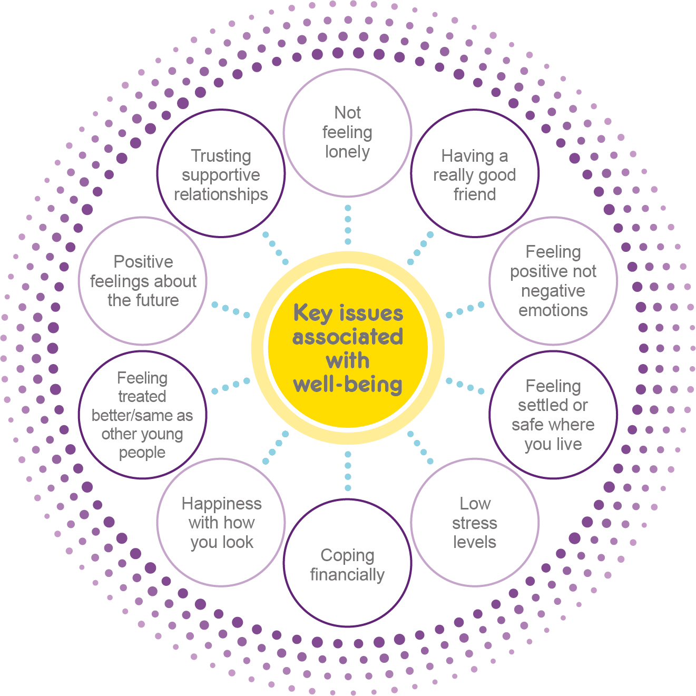
Improve connections and relationships
Support emotional well-being and mental health
Provide
practical and
financial support
Improve accommodation support
Notes:
Recommendation
Pay particular attention to the specific areas care leavers highlight locally, as well as the ten key issues we find are associated with well-being, i.e.
Improve connections and relationships (to develop friendships, trusting supportive relationships and addressing loneliness);
Provide emotional and mental health support (to address stress, high negativity and low positivity and help care leavers feel good about their future);
Provide money management and financial support (to support care leavers to cope financially);
Improve accommodation support (to help care leavers feel

Slide 17
Using young people’s voices to change
the care system
Local authorities
Nation-wide
LAs understand experience of their children & young people (CYP)
Develop local responses & feedback to CYP
National understanding of well-being from young people’s perspective
Benchmarking
Comparisons with general population
Notes:
Influencing and inform

Slide 18
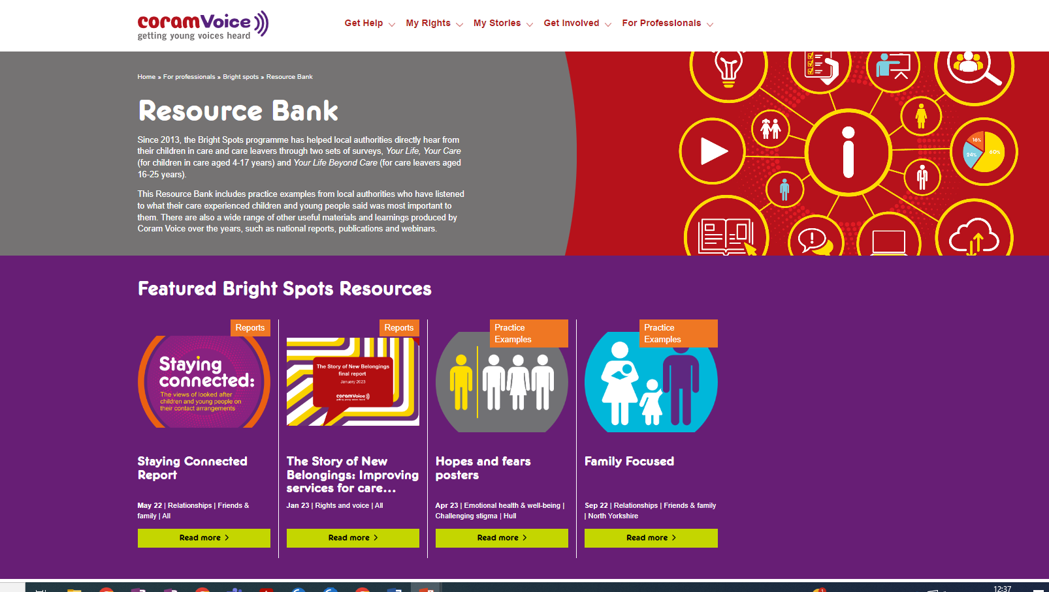
https://coramvoice.org.uk/for-professionals/bright-spots/resource-bank/
Notes:
We continue to learn from children and young people in the Bright Spots programme by working with local authorities across the country to capture how their children and young people are doing.
The local authorities who have made the most of the Bright Spots programme have used the surveys to drive change locally.
There are some great examples of how local authorities have listened to their children and young people in our Resource Bank , the updated version of which is launched alongside this report. We encourage services to seek ways to co-produce service improvements with children and young people to address the issues they say would make their lives better.
link
You can see examples of these in our resource bank

Slide 19
Find out more about the Bright Spots programme and read the full research reports on the Coram Voice website.
https://coramvoice.org.uk/brightspots
Email
Claire.Baker@coramvoice.org.uk
Bright Spots publications
https://coramvoice.org.uk/for-professionals/bright-spots/bright-spots-publications/

