Slide 1
Rights and Voice
Hertfordshire County Council
Our Exciting Life
Changing Plan
June 2023
Hertfordshire Corporate Parenting strategy titled – Our Exciting Life Changing Plan is based on their Bright Spots findings and focuses what young people said was important to them
This is a practice example from the Bright Spots Programme www.coramvoice.org.uk/brightspots

Slide 2
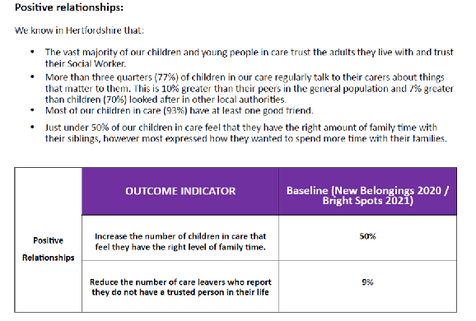
Why?
The Corporate Parenting Strategy was produced following a series of conversations with their children and young people who are the experts and their families and carers
What difference is it making?
‘The local authority’s corporate and political leaders prioritise the needs of children. They take their corporate parenting responsibilities very seriously and champion children’s services across the council and with partner agencies. Leaders are ambitious for Hertfordshire’s children.’ (Ofsted)
What did they do?
The new corporate parenting strategy is structured by the domains the children selected – the focus is now on what children feel makes a difference to their well-being – the outcomes have been re-shaped to measure these differences.
Young people were asked what terminology they wanted to see in the strategy– they voted for ‘family time’ or ‘time with family’ instead of ‘contact’ and for ‘meetings with young people rather than CLA reviews
They used the survey results to measure real outcomes for their children and young people rather than key performance indicators-(See opposite)
[space to add images, expand on what text]
‘We are extremely proud of Hertfordshire’s children in care and care leavers and committed to do all that we can to ensure they can access everything that the county has to offer and support them to feel accepted, safe and loved’. Herts CEO, DCS, lead member, council leader joint statement

Slide 3
Hertfordshire County Council
Our Exciting Life Changing Plan
June 2023
Why? The Corporate Parenting Strategy was produced following a series of conversations with their children and young people who are the experts and their families and carers.
What?
Young people named the plan and it is based on what young people have said will make the difference to their lives.
Young people decided on the language used in the plan.
The outcomes measure real outcomes for children in and leaving care – not the usual KPIs.
Impact: They take their corporate parenting responsibilities very seriously and champion children’s services across the council and with partner agencies. Leaders are ambitious for Hertfordshire’s children.
www.coramvoice.org.uk/brightspots
Notes:
Case study for presentations or online video

