Slide 1
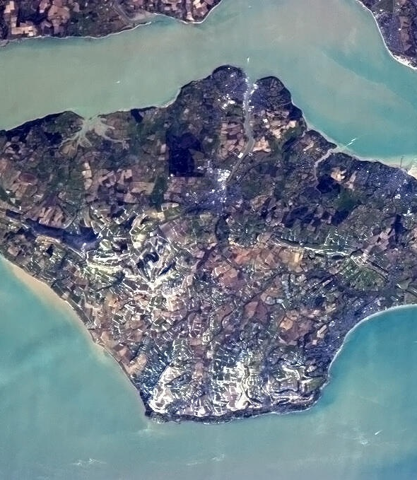
Introducing Isle of Wight Council
The Island is a unique place (23x13 miles) with a population of just 141,00 people.
We are a unitary authority that covers the whole Island.
We support 166 care leavers.
8 Personal Advisors , 1 housing Personal Advisor, an administrator and the team manager.
No University, only one hospital and one college.
If the young people we support want to entre higher education they may need to commute or find accommodation on the mainland.
Accommodation is limited across the Island, and this impacts the young people that use our service.
This Photo by Unknown Author is licensed under CC BY-SA

Slide 2
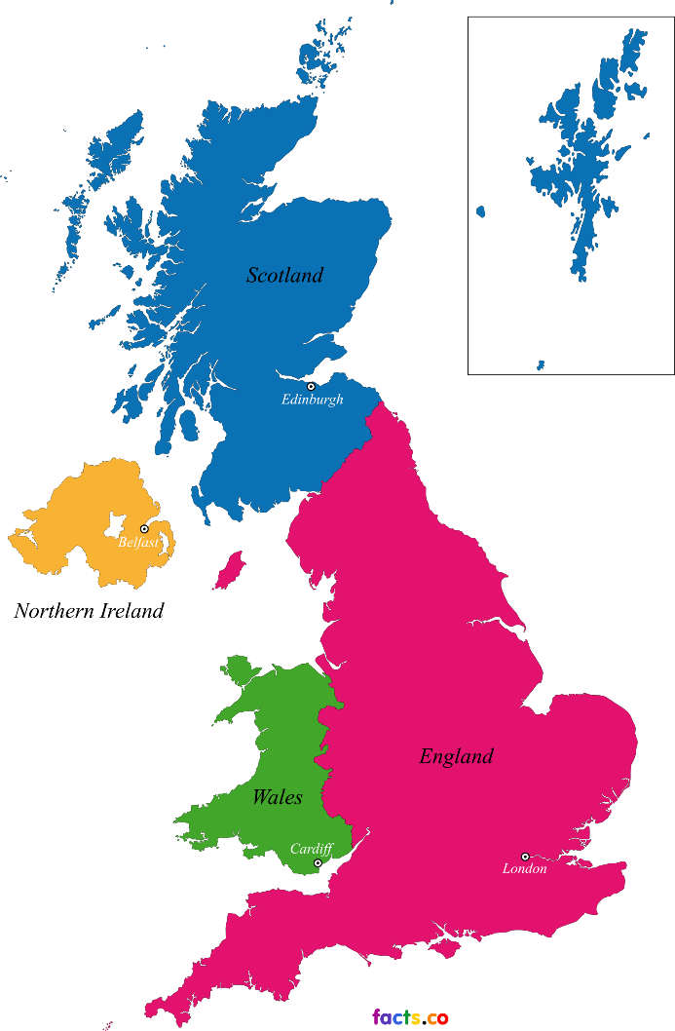
How we work on the Island
One of the challenges we face is time spent travelling – including going to Leeds, Plymouth, Wales and more.
However, we are a dedicated team who do what ever is needed to ensure we maintain our mainland visits, thus contributing to the positive relationships we build with those we support.
We support young people with different educational and health needs.
We work with accommodation providers, NHS and other agencies.
We endeavour to adjust everything we do to meet the needs of the care leavers we support so information is accessible.
This Photo by Unknown Author is licensed under CC BY-SA

Slide 3
Bringing Bright Spots to the Isle of Wight
Survey launched on Monday 13th February 2023.
February 2022 - visit data showed 100% completion, meaning that the engagement was high from the young people we support year on year.
Timing of the survey launch was carefully discussed.
As a team we had taken over participation, and worked hard to involve our care leavers in events leading up to the launch date.
Discussions with young people about what the Bright Spots survey is and the importance of sharing their voice.
We felt the timing was right!

Slide 4
Launching the survey
We already had the data from the pervious survey.
‘You said…We did…’ – used this to help us prepare, and show that we had listened to what young people had told us previously, be that good or bad, we wanted to hear everything, and we made that clear to each individual.
In 2022, our data showed 100% engagement from our care leavers in February and March, and this influenced our decision on when to go live with our survey.
We made sure that the survey reached every care leaver and assessed if they would need support from their service provider, friends or family to complete the survey.
We asked young people what they felt they needed to be able to work through the questions.

Slide 5
Delivering the survey
We went to local businesses to look for support in the way of draw prizes.
A draw every Friday where care leavers who had completed the survey could win prizes.
Staff WhatsApp group with daily updates to keep an eye on progress.
Daily debriefs to cover potential issues, like colleagues on leave and who, in their absence, would reach out to their young people.
We got competitive, as we wanted to succeed in sharing the voice of those who use our service to continue to improve our practice.
Bright Spots took priority as our Managers understood that the voice of our care leavers is what drives us to succeed for them.
This was the first year that Bright Spots was in our hands and our team took ownership of its success.

