Slide 1
Smotiau Disglair | Bright Spots
Proses Powys | Powys’ Process
Medi 2023​​ | September 2023

Slide 3
Our Beginning

Slide 4
Our Beginning
Our collaboration with Coram Voice:
Aims to improve the wellbeing of children and young people in care
Demonstrates our and partner agency’s ongoing commitment
Facilitates young person engagement with our service improvement
Allows us to listen to the voices of the children and young people
Smooth commissioning process, it was completed within the same financial year
Inclusion in the Children’s Services annual work plan
Provide a clear strategic lead from the outset
Linking to our Participation Strategy
Aligns with our wider strategic aims
Ensure support from partner agencies and the local authority
Meeting the needs of the Children Looked After
Provides reassurances e.g., Children Looked After feel safe in their Foster Families
Provides clarity on key areas requiring further development

Slide 5
Our Beginning

Slide 6
Project Group
Our Beginning

Slide 7
Project Group
Our Project Group
Senior Manager Safeguarding & Quality Assurance as Lead
Project Manager from Business Support Service Area
Senior Manager Corporate Parenting
Team Managers from our Children Looked After Teams
Senior Manager Intervention & Prevention
Principle Social Workers from our 14+ Team who line managed our Personal Advisors
Corporate Communications Lead for Children’s Services
Participation Officer
Education Leads
Health and School Nurse Leads
Advocacy Leads
Ian Stewart-Watson from Coram Voice

Slide 8
Project Group
Our Beginning

Slide 9
Project Group
Our Beginning
The Surveys

Slide 10
The Surveys
Bright Spots Programme Implementation
Distribution of ‘Your Life, Your Care’ survey to Children aged 4-18 in Care
Development of bilingual communication for Children, Young People and Trusted Adults
Identification of Trusted Adults via a spreadsheet
Webinar for Trusted Adults led by Ian and Powys
Support to Children & Young People
Consideration of a private and safe environment
Timing planning
Post-survey support for potentially upset children
Follow-up on any actions required
Submission process

Slide 11
Project Group
Our Beginning
The Surveys

Slide 12
Sharing Results
Project Group
Our Beginning
The Surveys

Slide 13
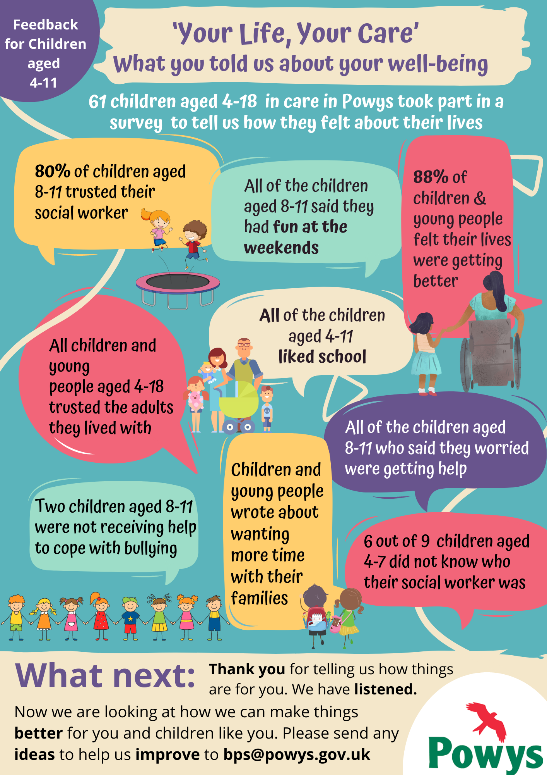
Sharing Results
Listening to Young People
Opportunity to listen systematically to children and young people
Understanding their perception of care, wellbeing, relationships, and rights
Coram Voice Report and Presentation
Received a detailed report and an overview PowerPoint from Coram Voice
Included responses and quotes from survey respondents
Accessibility
Communication representative designed an easy-to-understand leaflet
Key survey results shared with children and young people
Multi-Agency Hybrid Webinar
Conducted a multi-agency hybrid webinar for all Children’s, Education, Health Staff as well as the Young People’s Foster Carers
Led by Coram Voice with Powys as the Chair
Solicited staff views on responding to the survey findings

Slide 14
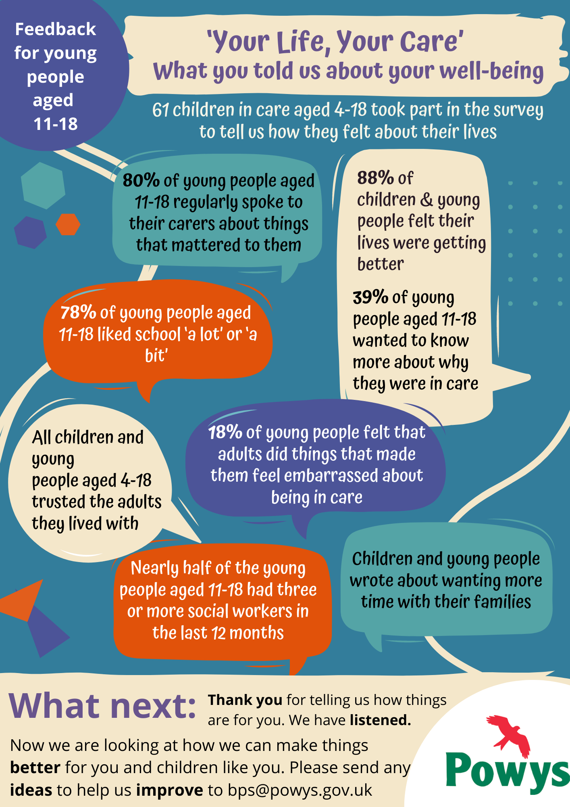
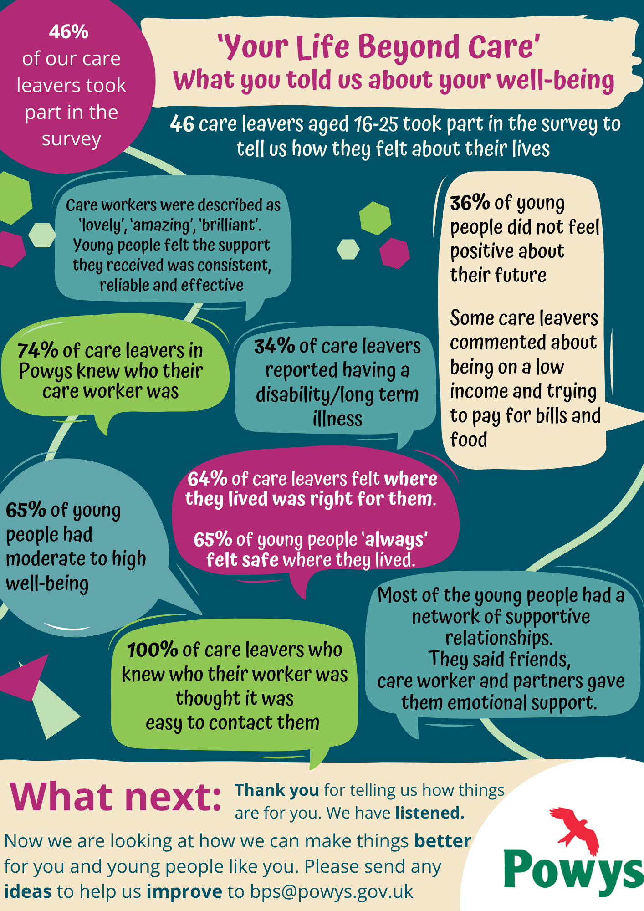
Sharing Results

Slide 15
Sharing Results
Project Group
Our Beginning
The Surveys

Slide 16
Sharing Results
Project Group
Our Beginning
Moving Forward
The Surveys

Slide 17
Moving Forward
Survey Findings Highlights
Provided us with reassurance and support for inspection readiness
There was a high level of trust in adults they lived with and they felt safe
88% of children and young people felt safe where they lived, exceeding the general population (82%)
88% of children felt their lives were improving
Areas for Improvement
Increased desire for understanding among young people regarding why they are in care
Action plan development across different domains
Worker retention and trust among care leavers
Benefits of the Bright Spots Survey
Systematic understanding of supported children and young people
Benchmarking against others
Confidence in evidencing successful practices
Clarity in identifying areas needing improvement

Slide 18
Sharing Results
Project Group
Our Beginning
Moving Forward
The Surveys

Slide 19
Diolch yn Fawr
Thank You

