Slide 1
What makes life good? What children in care say about their well-being Learning from the Bright Spots Programme
Susanna Larsson, Operations Manager

Slide 2
About the Bright Spots Programme
Developed in partnership with the Professor Julie Selwyn (Rees Centre at the University of Oxford)
Co-produced with children and young people
Explores the how children in care and care leavers feel about their lives.
+ 22 local authorities in Wales for the Basic Income Pilot

Slide 3
About Bright Spots and the Your Life, Your Care Surveys
Originally funded by Hadley Trust
Annually work with around 15 LAs conducting 20-30 surveys
Development work
Workshops with 140 children in care (YLYC) – What makes life good?
Anonymous online surveys created: 4-7yrs; 8-11yrs, 11-18yrs
Literature review
Piloting and cognitive interviews
Comparison national data identified e.g.
ONS wellbeing measures
The Good Childhood Report
Understanding Society
Psychometric analysis of indicators
Identify how children & young people feel
Inform service development
Notes:
The Bright Spots programme was developed as a partnership between Coram Voice & the University of Oxford supported by the Hadley Trust to help LAs:
Identify how children and young people (CYP) feel
Use that knowledge to develop services & strategic thinking.
Importantly, the survey tools are based on what 170 children in care and care leavers said was important to them. We conducted workshops to explore what they felt made their lives good and they helped us narrow down the questions we ask.
The surveys are strongly evidence based – workshops drew on international literature reviews of research into children in care and care leavers views and well-being.
By asking the same questions of CYP around the country we can compare your children in care and care leaver’s experiences to those in other areas and see where they are particularly struggling or doing well.
Wording of questions chosen to mirror those in national studies of children and young people’s well-being so that, when relevant, we can compare the experience of children in care and care leavers to the general population.
We carefully tested and refined the question by piloting and conducting cognitive interviews – a technique where you ask children and young people how they understand and respond to the questions to make sure they interpret them in the same way as we intended, that they felt ok about completing the questionnaire – as a result we changed the wording or removed some of the questions.

Slide 4
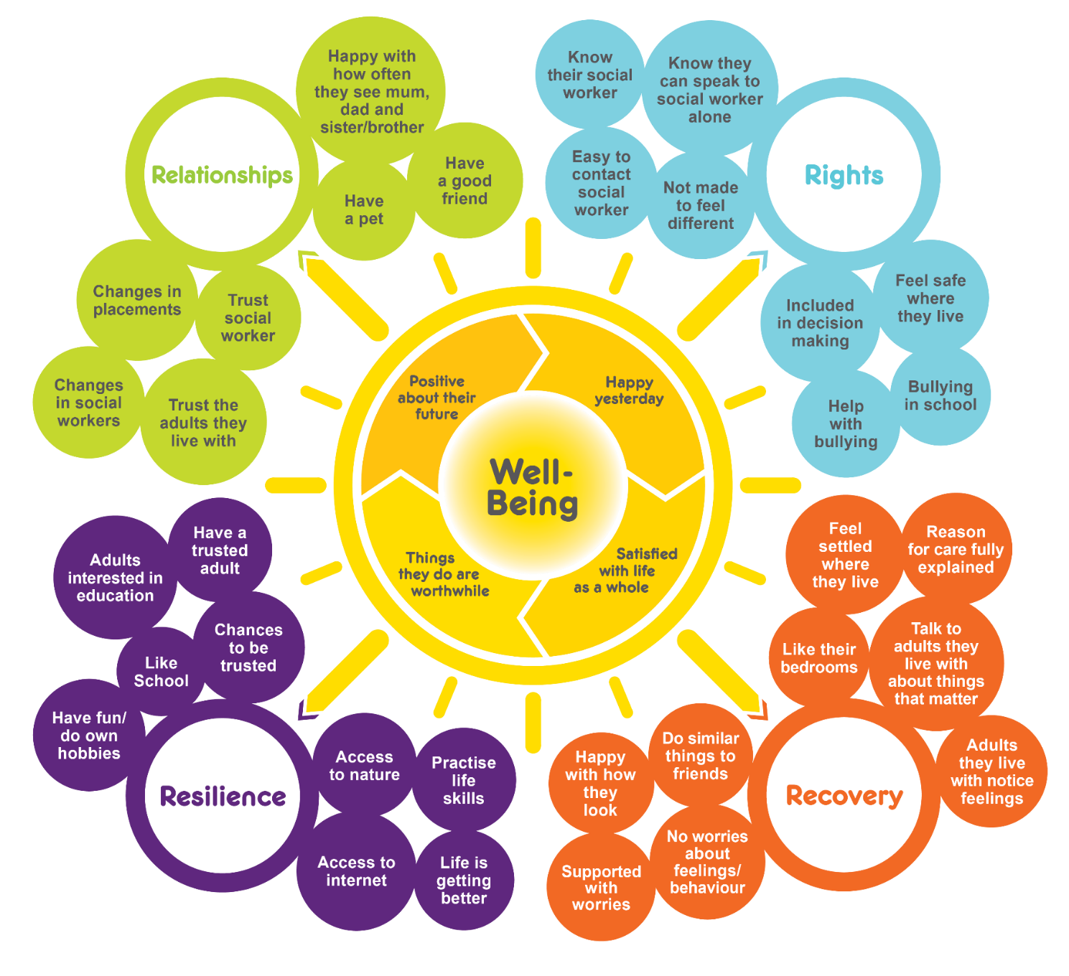
Your Life, Your Care
Notes:
Our new report 10,000 voices highlights what children in care have said about their well-being. The questions it explores are the areas that they children in care told us were important.
Each of the Bright Spots indicators represents a question in the Your Life, Your Care surveys.
Each is important as they point services in the direction of issues to address to make children and young people’s lives better.

Slide 5
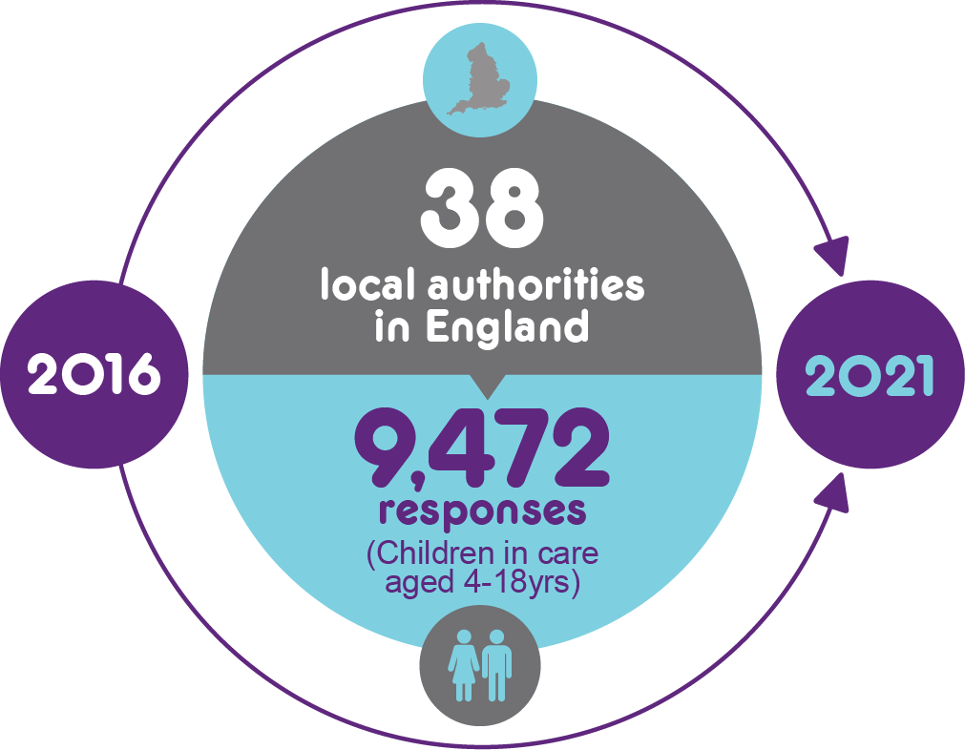
10,000 Voices
Children in care’s views on their well-being
https://coramvoice.org.uk/10000-Voices-Report
Notes:
The report summarises what we have learned from the 9,426 responses we received over 5 years from children in care aged 4 to 18.

Slide 6
Pilot in Wales in 2018
Six local authorities – Caerphilly, Cardiff, Flintshire, Pembrokeshire, RCT and Swansea.
Response rate ranged from 21%-44% by LA.
Findings disseminated in the 6 LAs: attended by 88 professionals.
Full report available to read online:
https://coramvoice.org.uk/wp-content/uploads/2019/08/bright_spots_-_wales_report_-_final_1.11.18_english.pdf
https://coramvoice.org.uk/wp-content/uploads/2019/08/bright_spots_-_wales_report_-_final_1.11.18_cymraeg.pdf

Slide 7
Wales: 686 children and young people
Age group | Boys | Girls | Prefer not to say | Total
11-18yrs | 183 | 186 | 9 | 378 (55%)
8-11yrs | 101 | 83 | 2 | 186 (27%)
4-7yrs | 53 | 67 | 2 | 122 (18%)
Total | 337 (49%) | 336 (49%) | 13 (2%) | 686

Slide 8
Although there is often a focus on the additional challenges care experienced children and young people face, the Bright Spots findings show that many do well.

Slide 9
Life improving
Welsh LAs:
77% (8-18yrs)
I feel healthy, safe, and supported. From what my life was like 3 years ago it is now much, much better.
11-18yrs
Notes:
Since we started the surveys back in 2015, we have consistently found that many children and
young people write positively about their experiences of being in care.

Slide 10
Feeling safe
Wales: 86%
(11-18yrs)
I actually feel so safe now and that means I don’t get hit by mum or dad and don’t have to hear them swear and hear them arguing. My foster parents are so kind, loving, and so funny! 8-11yrs
Compared with the general population, a larger percentage
of children in care felt safe where they lived
Notes:
Compared with the general population, a larger percentage
of children in care felt safe where they lived…

Slide 11
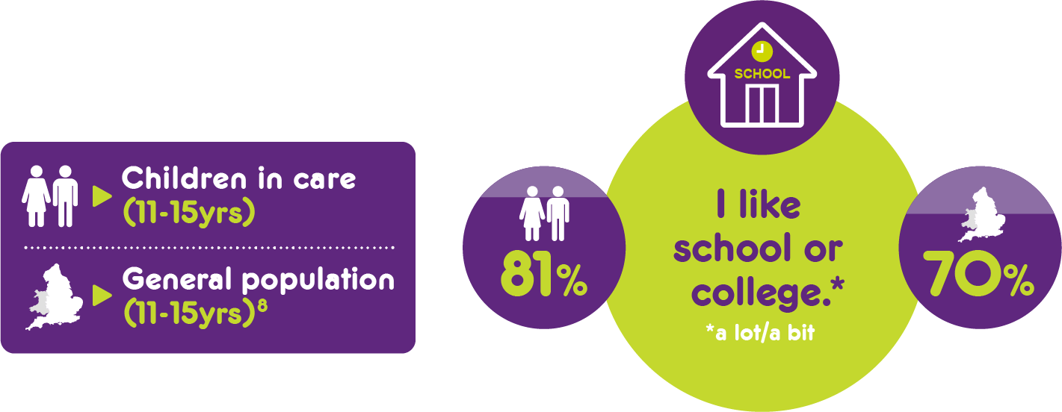
Liking school
I am perfectly happy at school and at home and there is nothing I want [social services] to change. 8-11yrs
…liked school
Wales: 71% (11-18yrs)
83% (8-11yrs)
Notes:
Compared with the general population, a larger percentage
of children in care felt safe where they lived, liked school…

Slide 12
Adults take an interest in education
I love my family… I always get help with my homework. 8-11yrs
…and felt the adults they lived with took an interest in their
education
Wales: 94%
Notes:
….and felt the adults they lived with took an interest in their
education. Unlike many other indicators, feeling that carers
were interested in their education did not decline during
the teenage years.
However, in all these areas there were of course still children who described struggling.

Slide 13
Very high well-being
When asking children in care about their life satisfaction, happiness and whether they feel the things they do in life are worthwhile a higher proportion report very high well-being than in the general population.

Slide 14
However, some children and young people still struggle and there are areas where they do worse than their peers in the general population.

Slide 15
Low well-being
A larger percentage of young people also rated their life satisfaction, happiness and feeling that the things they did in life were worthwhile as ‘low’.
Notes:
Although a higher proportion reported very high well-being compared to their peers in the general population a larger percentage of young people also rated their life satisfaction, happiness and feeling that the things they did in life were worthwhile as ‘low’.

Slide 16
Overall well-being
1 in 30
4-7 year olds
1 in 20
8-11 year olds
1 in 6
11-18 year olds
I want to see mummy more. I want to play in the park more. I want to be happy because I am not happy in foster care. 4-7yrs
I would like to get a better relationship with my carer so I feel safer where I live. I would like someone who can understand my thoughts and feelings. I would prefer to live closer to my school, my friends and my family because I feel safer. 8-10yrs
hate being in care and if I say something that is worrying me, it gets blown out of proportion. 11-18yrs
Notes:
By the teenage years 1 in 6 young people report having low well-being

Slide 17
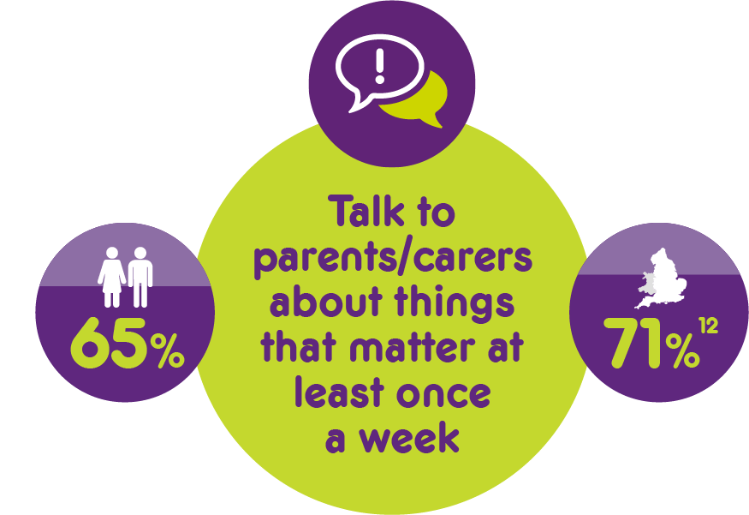
Compared to the general population fewer young people in care had a good friend or talked to the adults they lived with about things that mattered to them.
[What would make care better?] If I could talk to my foster dad more..
11-18yrs
Wales: 91% (11-18yrs)
95% (8-11yrs)
Notes:
Compared to the general population fewer young people in care had a good friend or talked to their adults they lived with about things that mattered to them.

Slide 18
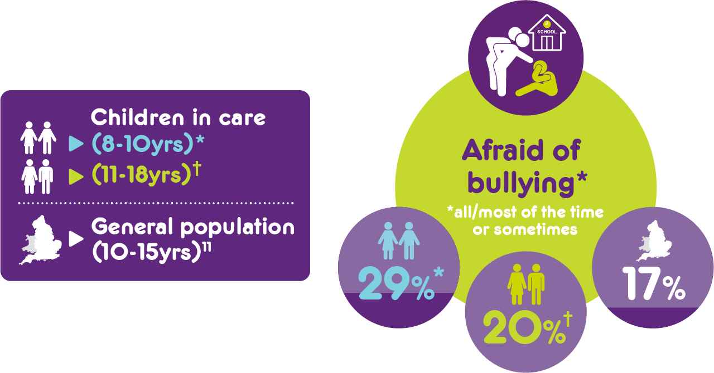
Bullying
I get a lot of worries at school. I am not liked very much. 8-11yrs
Notes:
Some children in care felt afraid of going to school because of bullying.

Slide 19
Stigma of being in care
When I was younger, it was a lot more difficult. Adults always felt that they could see you when they wanted to - at school and at club - that was embarrassing. As I got older, I was able to say that actions like this was not ok, so to stop. 11-17yrs
1 in 8
young people (11-18yrs) felt that adults had done things to make them feel embarrassed about being in care
Notes:
Some felt that adults had had done things to make them feel embarrassed about being in care…

Slide 20
Our findings clearly showed the importance of not treating all children in care as if they are the same. Whilst they had things in common, the challenges that children and young people faced also differed with age, sex, placement type and ethnicity.
Notes:
Our findings clearly showed the importance of not treating all children in care as if they are the same. Whilst they had things in common, the challenges that children and young people faced also differed with age, sex, placement type and ethnicity.

Slide 21
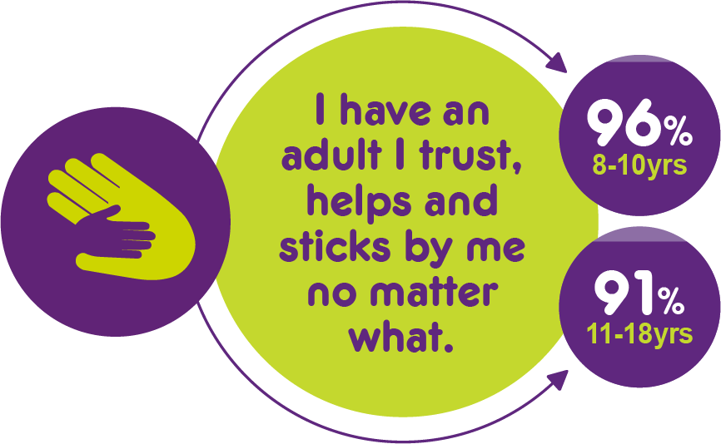
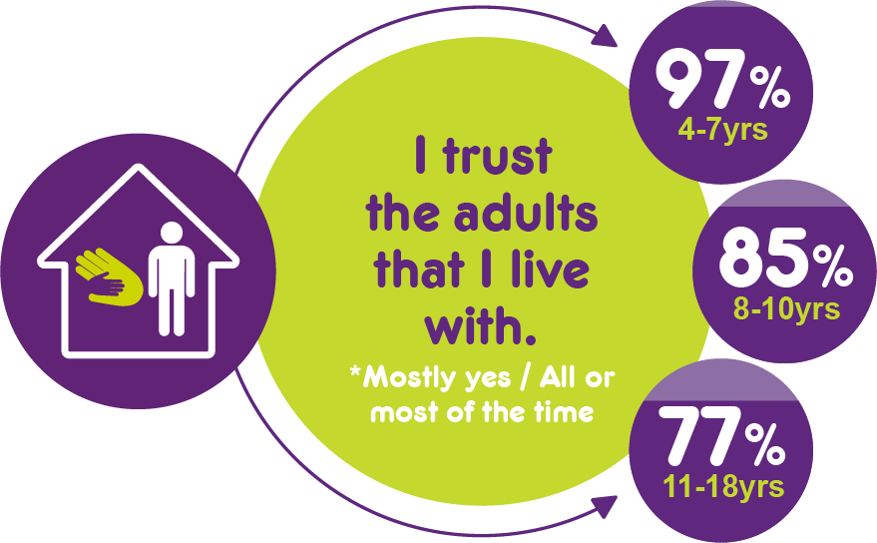
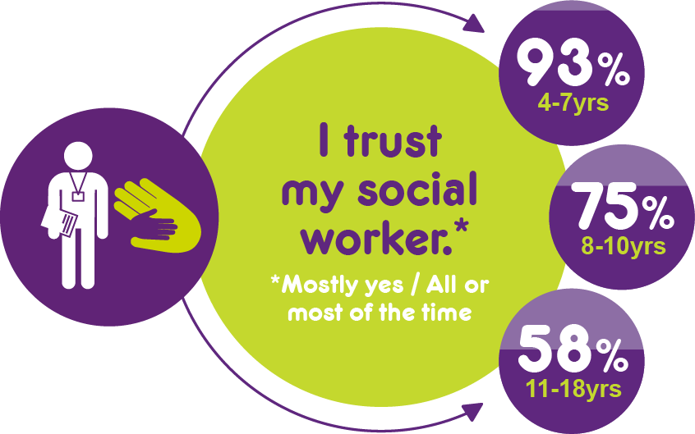
Many of the comments from young people illustrated the importance of trusting relationships, but as children became older fewer reported trusted relationships.
I really trust my carers and love living with them. 8-10yrs
I’ve met my new social worker once and I don’t have her number so I will build up a relationship before I can trust. 11-18yrs

Slide 22
I would like to know my social worker’s name because there’s lots of them and I can’t remember all of them. 4-7yrs
My social worker always includes me in decisions. Out of all the social workers I’ve had [name] is the one I’ve connected to the most. 11-18yrs
As they got older a higher proportion
Knew who their social worker was
Felt involved in decision making
Felt the reasons why they were in care had been fully explained
Even when I say my opinion it doesn’t get listened to, and my social worker will always go against what I have said. So, I might as well say nothing at all. 11-18yrs
Notes:
Most children in care felt included in the decisions that social workers made about their lives at least ‘sometimes’. However, around 1 in 7 ‘hardly ever’ or ‘never’ felt included.
1 in 5 of the youngest children did not know who their socialworker was, twice as high as for the older children in care.
The proportion who felt they got to practise life skills increased from 83% at the beginning of secondary school to 95% by age 17

Slide 23
Girls reported lower well-being than boys.
Notes:
A greater proportion of young people in residential care and living ‘somewhere else’ (mostly supported accommodation) reported lower well-being, e.g. more did not feel safe where they lived, did not have a trusted adult, felt the adults they live with did not notice how they were feeling and felt that they were unable to do the same things as their friends.

Slide 24
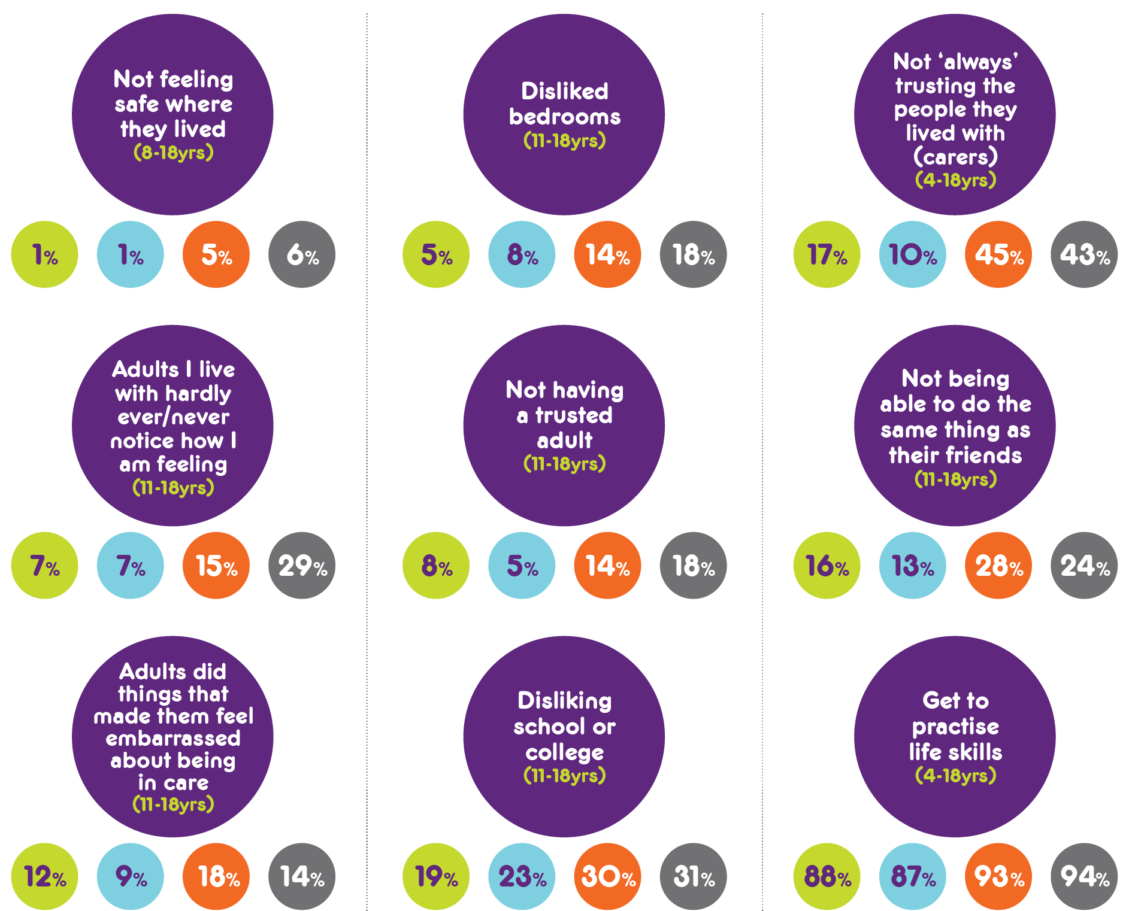
Placement type
Notes:
A greater proportion of young people in residential care and living ‘somewhere else’ (mostly supported accommodation, prison or hospital) reported lower well-being, e.g. more did not feel safe where they lived, did not have a trusted adult, felt the adults they live with did not notice how they were feeling and felt that they were unable to do the same things as their friends.

Slide 25
All the things that we ask about in the Your Life, Your Care survey are important to children in care’s well-being. But our analysis showed that some things were more strongly associated with well-being. These will be particularly important to focus on in order to make children in care’s lives good.

Slide 26
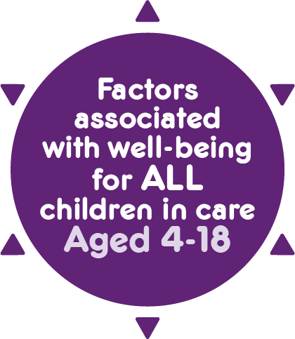
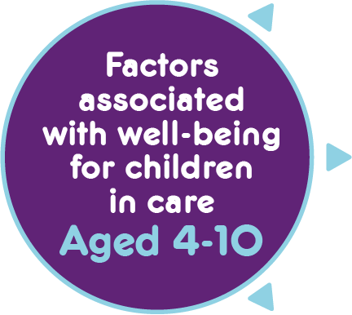
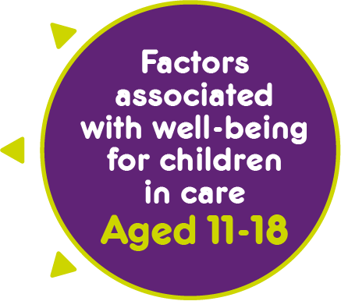
Factors associated with well-being
Notes:
For all children and young people having good friends and trusting and supportive
relationships were really important. This included trusted carers and social workers.
► Liking school influenced well-being for all age groups.
► Feeling safe where they lived and settled was also important for children in care whether
they were aged 4 or 17.
► Seeing mothers, fathers, brothers and sisters as often as children and young people
wanted was highlighted by all age groups.
The youngest children (4-10yrs) wanted to have trusting relationship with carers who noticed
their feelings and did not shout. For the oldest age group, having trusted adults, as well as
being given opportunities to be trusted was associated with well-being.
► While relationships with carers was also very important for the older young people, the support
gained from friends was also key to their wellbeing, especially being able to do the same
things as peers. Younger children were asked a different question and for them having fun at
the weekend mattered.
► A larger percentage of younger children felt afraid to go to school because of bullying
compared with 11-16 year-olds. Teenagers with low well-being often struggled with worries
about feelings and behaviour and girls in particular were unhappy with how they looked.
► Nearly half of the youngest children (4-7yrs) did not feel that the reasons they were in care had
been fully explained, whereas being involved in decision making and practising life skills
was associated with well-being for older young people in care.

Slide 27
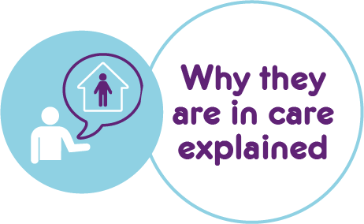
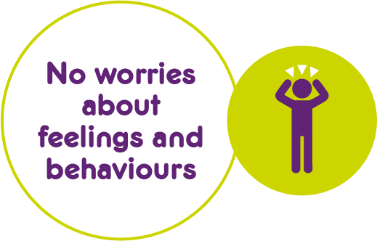
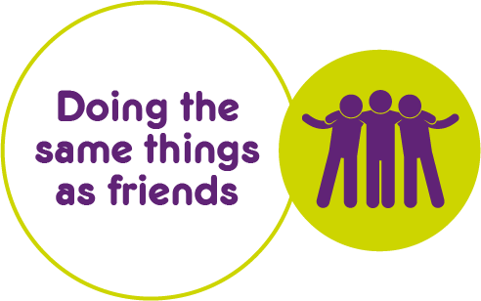
Factors associated with well-being
Notes:
For all children and young people having good friends and trusting and supportive
relationships were really important. This included trusted carers and social workers.
► Liking school influenced well-being for all age groups.
► Feeling safe where they lived and settled was also important for children in care whether
they were aged 4 or 17.
► Seeing mothers, fathers, brothers and sisters as often as children and young people
wanted was highlighted by all age groups.
The youngest children (4-10yrs) wanted to have trusting relationship with carers who noticed
their feelings and did not shout. For the oldest age group, having trusted adults, as well as
being given opportunities to be trusted was associated with well-being.
► While relationships with carers was also very important for the older young people, the support
gained from friends was also key to their wellbeing, especially being able to do the same
things as peers. Younger children were asked a different question and for them having fun at
the weekend mattered.
► A larger percentage of younger children felt afraid to go to school because of bullying
compared with 11-16 year-olds. Teenagers with low well-being often struggled with worries
about feelings and behaviour and girls in particular were unhappy with how they looked.
► Nearly half of the youngest children (4-7yrs) did not feel that the reasons they were in care had
been fully explained, whereas being involved in decision making and practising life skills
was associated with well-being for older young people in care.

Slide 28
Recommendation:
Make life good
Carers who they trust and who are sensitive to their feelings
Fun in their free time and do similar things to their friends
Somewhere to live where they feel safe and settled
Make life good
Opportunities to be trusted and practise life skills as they get older
Social workers who don’t change, are easy to contact and they trust
Involvement in and information about their care and their families
Opportunities to build and keep relationships with the people who are important to them
Notes:
We therefore recommend that to make life good for children in care they need:
Carers who they trust and who are sensitive to their feelings
Somewhere to live where they feel safe and settled
Social workers who don’t change, are easy to contact and they trust
Opportunities to build and keep relationships with the people who are important to them
Involvement in and information about their care and their families
Opportunities to be trusted and practise life skills as they get older
Fun in their free time and chances to do similar things to their friends

Slide 29
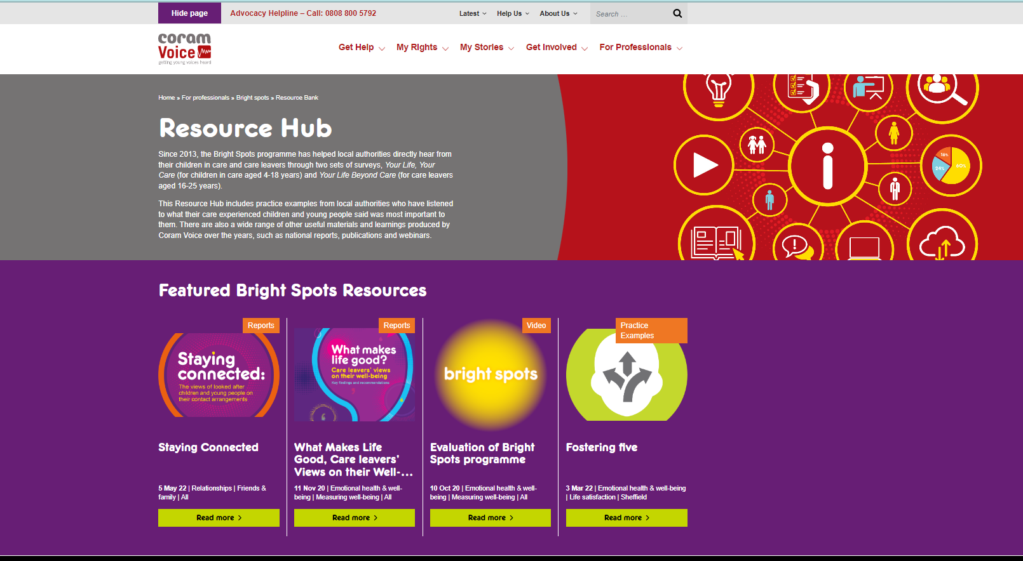
https://coramvoice.org.uk/for-professionals/bright-spots/resource-bank/
Notes:
We continue to learn from children and young people in the Bright Spots programme by working with local authorities across the country to capture how their children and young people are doing.
The local authorities who have made the most of the Bright Spots programme have used the surveys to drive change locally.
There are some great examples of how local authorities have listened to their children and young people in our Resource Bank , the updated version of which is launched alongside this report. We encourage services to seek ways to co-produce service improvements with children and young people to address the issues they say would make their lives better.
link
You can see examples of these in our resource bank

Slide 30
Find out more about the Bright Spots programme and read the full research reports on our website.
https://coramvoice.org.uk/brightspots
or email brightspots@coramvoice.org.uk

