Slide 1
Spotlight on practice
Rights & Voice
Sheffield City Council
Integrating Bright Spots
into Community
Parenting Strategy
May 2024
Sheffield have used their recent Bright Spots findings to structure their new Community Parenting Strategy. This means that what matters to children and young people in and leaving care is at the very centre of what they do as corporate parents.
Find out more about the Bright Spots Programme

Slide 2
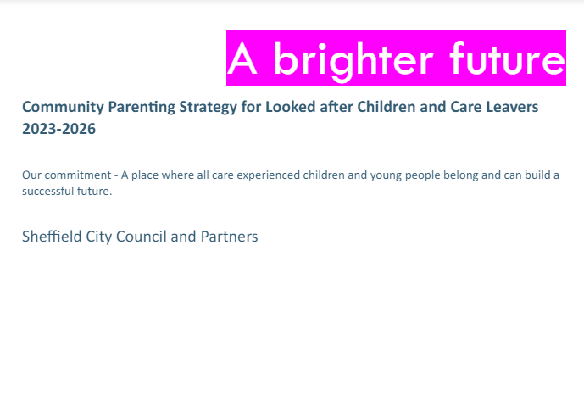
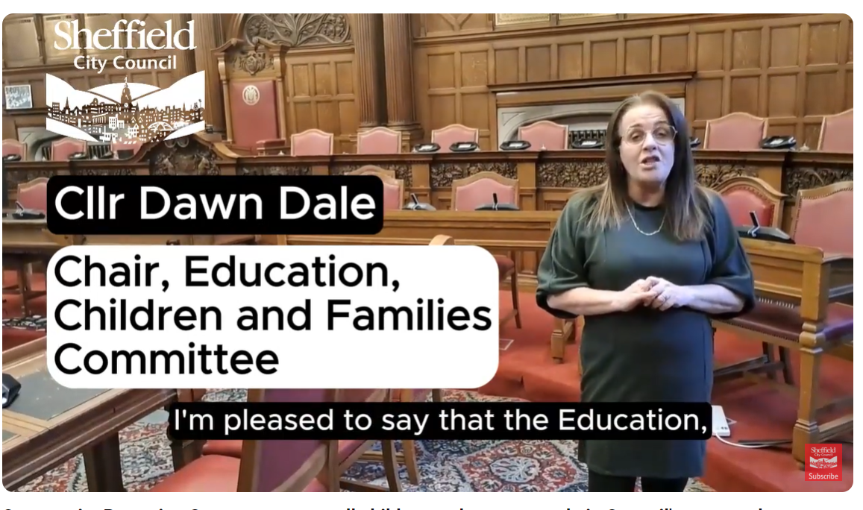
Why? Community (or corporate) parenting reminds us of the collective responsibility everyone has to make sure children in care and care leavers have opportunities to succeed and live happy lives. The new strategy, A Brighter Future, sets out in practical terms what it means for the council to be a ‘good parent’– everything is based on what children and young people say matters to their well-being.
What difference is it making?
It is the first time that such a strategy has been co-produced by young people in Sheffield. The strategy (Community Parenting Strategy ) is in place for 3 years (until 2026) & young people are integral to the scrutiny of progress against the priorities.
Each year a detailed Community Parenting business plan will be co-produced with young people – this will be used to implement the strategy and monitor impact.
Voice and Influence workers have made a film about being a good corporate parent. It is being used as a training tool.
What did they do?
The key priorities are built around the Bright Spots domains
and Sheffield’s survey findings:
Relationships – the people in your life (Priority)
High Aspirations and Resilience – parity of opportunity growing up (Priority)
Rights – entitlements, voice and participation
Wellbeing and Recovery – being and feeling healthy and happy (Priority)
5. Caring for those who care: Children and young people are nurtured by carers and workers who are well-resourced, valued and supported. (This priority area has been added by Sheffield)
Young people say:
“As care-experienced young people, we like that you are using the Bright Spots voices from care-experienced children and young people. As a team we have been involved in doing the Bright Spots research (promoting and taking part). We are using the Bright Spots research in all the work we do to ask professionals to improve and change the way we do things in Sheffield. We are looking forward to working alongside you and partners to co-produce the plans and help you to identify the priorities. We will be scrutinising your progress at our regular scrutiny panel meetings”.
Notes:
https://www.sheffield.gov.uk/sites/default/files/2024-05/community-parenting-strategy-2023-26.pdf
When training film is available we will add link

